Slide 1

Cloud Services: Azure
NETW211 Fundamentals of Cloud Computing
By: Danial Waseem
Administrating Professor: Joe Njoloma

Slide 2
Introduction
Cloud computing is an ever-growing industry and the reliance on cloud computing is set to increase. The fact of matter is technical architecture and physical resources that took months to put together are available in a matter of seconds by Cloud Computing. The FTC issued a statement stating, “Cloud computing is a central part of the economy, with companies projected to spend $576 billion on cloud computing in 2023.”
This project dives into Azure’s platform utilizing several cloud services. I will be showcasing the following application of cloud computing, including:
Virtual Machine Instances
Azure VNets and Subnets
Azure VM Security
Cloud Storage
Cloud Monitoring
Each section will brief what is to come and the steps taken, alongside images after to present each application or service utilized.

Slide 3

Virtual Machine Instances
The first step in our process is to create a virtual machine (VM) with Microsoft Azure. The VM is assigned to a created Resource group titled NETW211-DW and is deployed as a Windows Server 2019 Datacenter VM. This is a B1s VM with a smaller size of 1 vCPU, 1 GiB ram with 2 data disks, 320 IOPS(input/output per second) and 4GiB storage capacity. After creating a username and password the VM is deployed, which I can connect into it via remote desktop protocol connection or RDP. After successfully launching into the remote desktop session, the VM instance and Resource group NETW211-DW was deleted.

Slide 4
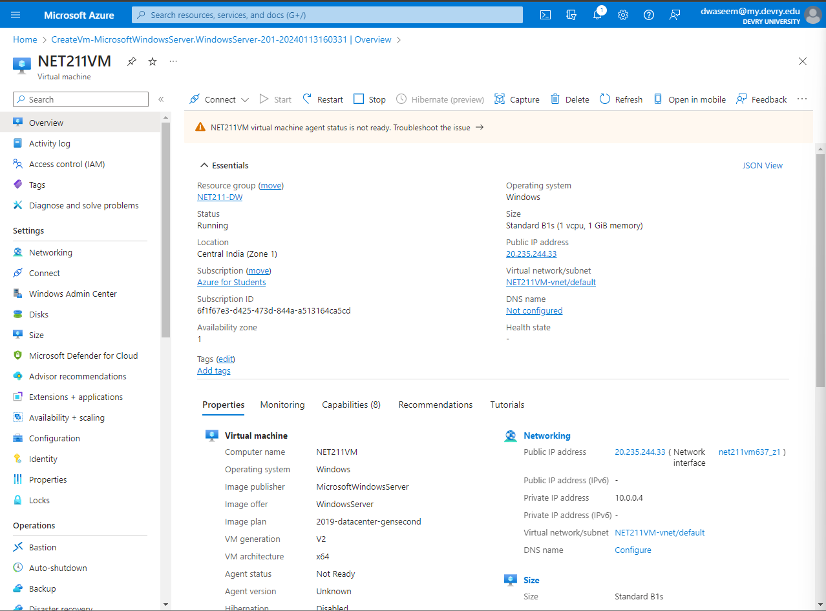
Deploying a VM in Azure
This screenshot shows the NETW211-DW VM page with information including my resource group name, subscription, public IP address. My DVU ID information in the top right corner of the Azure Portal.

Slide 5
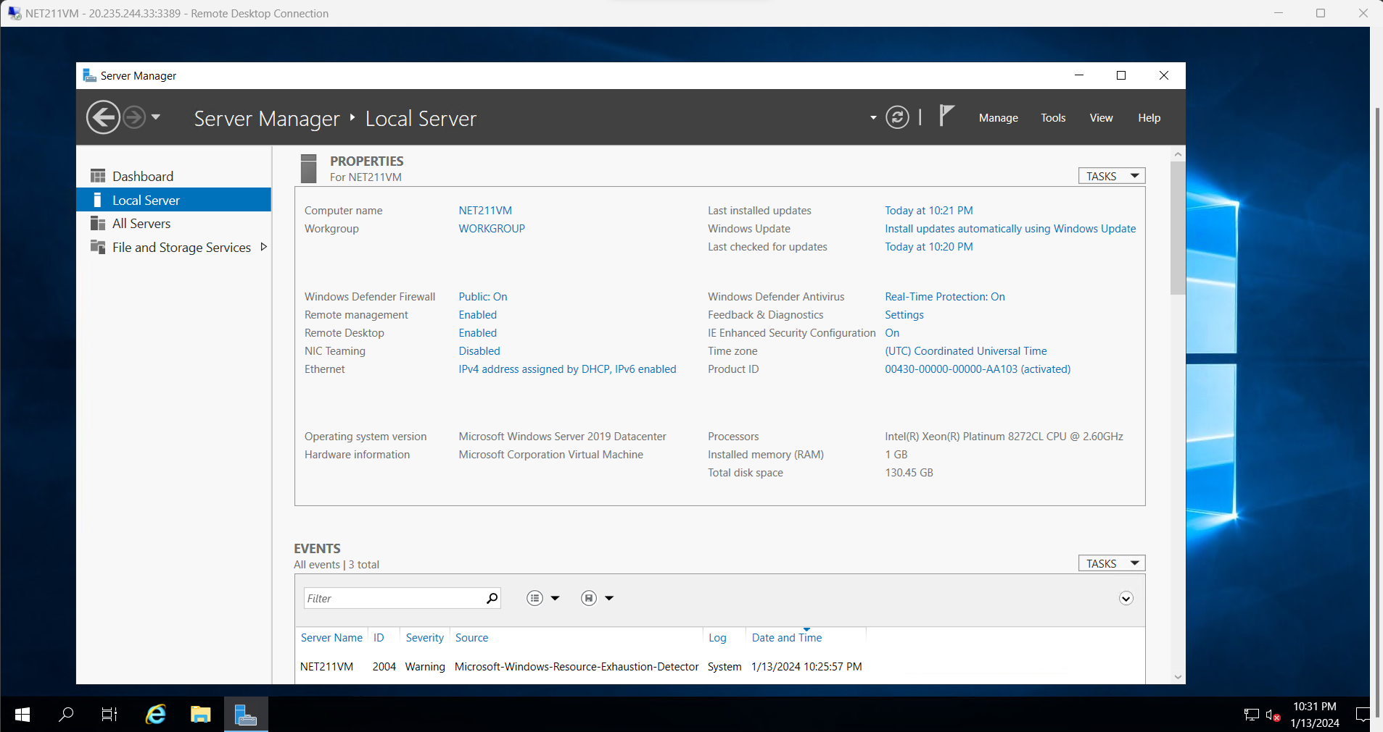
Connecting to the VM
This screenshot shows the PROPERTIES for NETW211VM page, including my computer name, operating system version, hardware information, etc.
This screenshot also shows the EVENTS section with the Date and Time information.

Slide 6
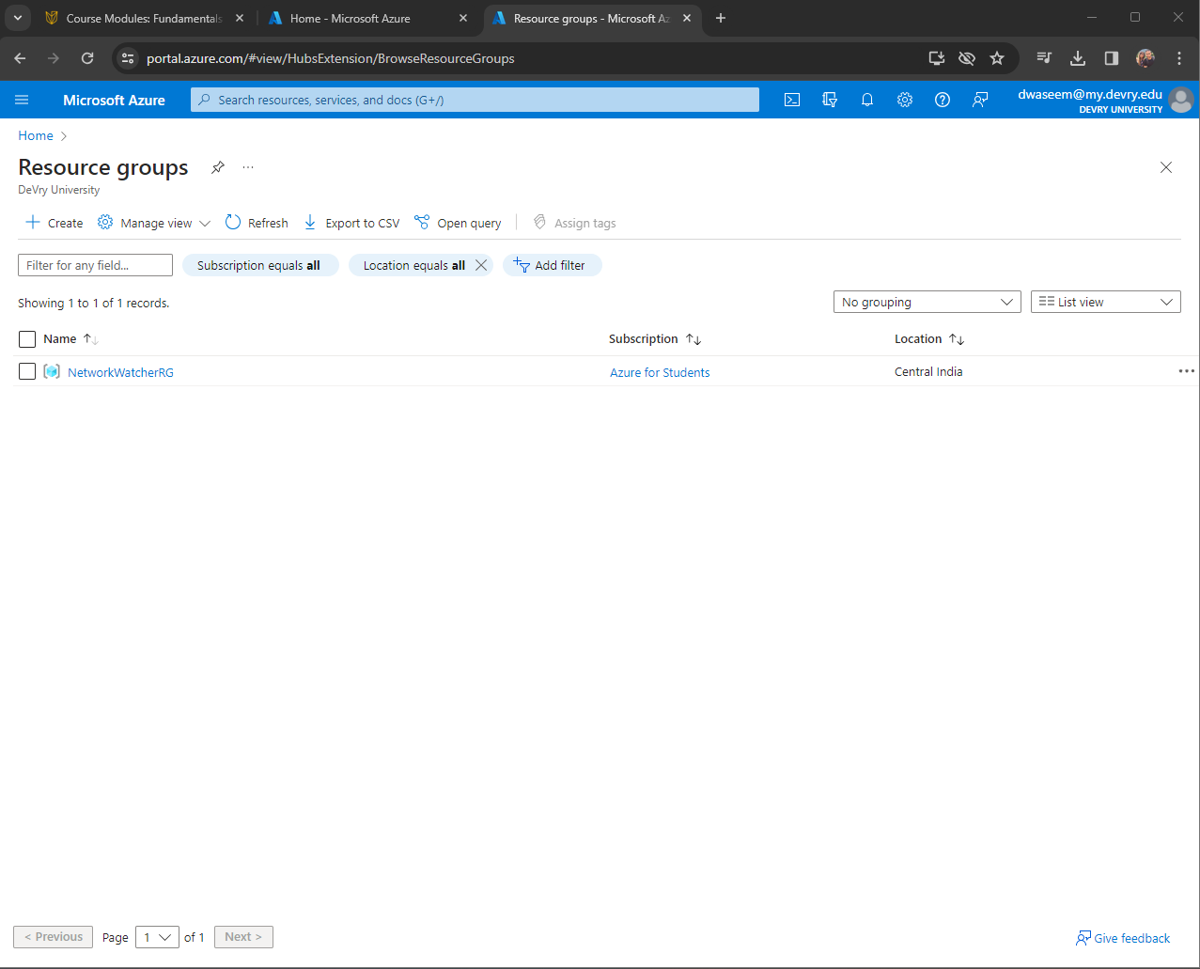
Deleting the VM
This screenshot shows Resource groups page, with the “No resources match your filters” message. My DVU ID information in the top right corner of the Azure Portal.

Slide 7
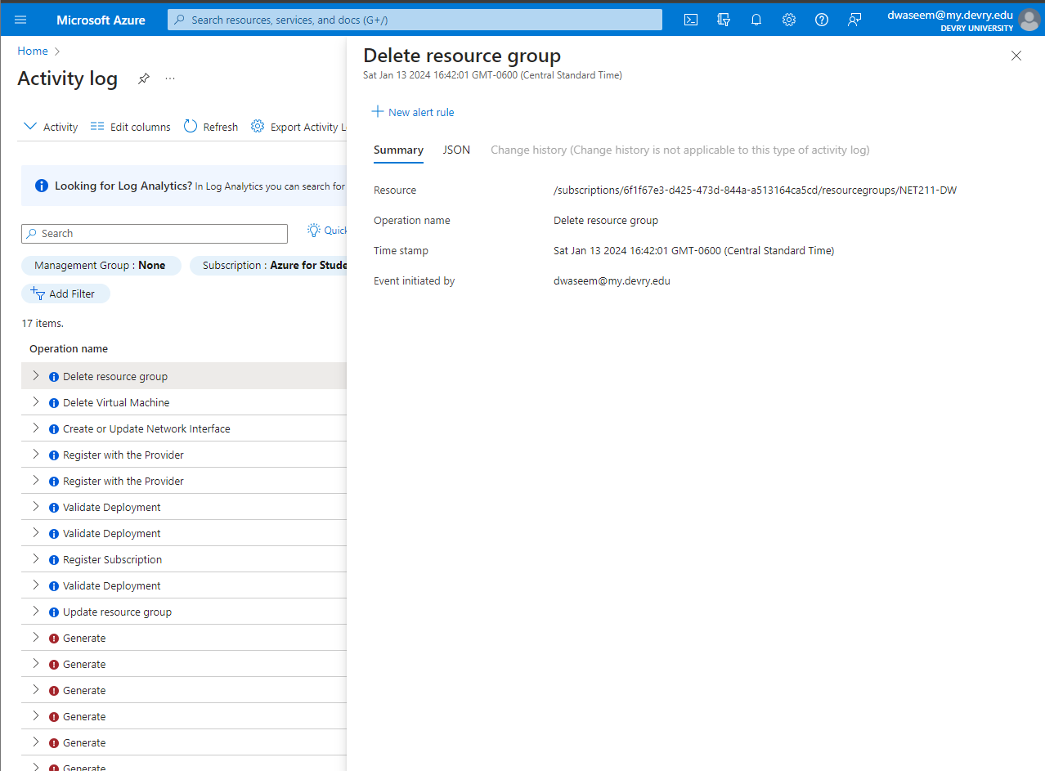
Screen shot of The NETW211-DW resource group deleted in activity log.

Slide 8
Azure VNet and Subnets
The next step is to set up two subnets within a virtual network for two virtual machines (VM) in the Azure environment. Deploying each VM with user defined VNET settings to the correct Subnet_0 and Subnet_1 addresses. I can verify by pinging from each Windows command prompt that emphasizes the connection between the virtual machines as successful and able to access an internet connection. To note we now have a total of 251 usable and available IPv4 addresses for each Subnet_0 and Subnet_1. In a traditional network two out of these addresses each are dedicated to the Network and Broadcast addresses, the first and last IP address. Azure utilizes five IP addresses within each subnet as reserved. Network address, Default gateway address, two DNS IP addresses to the virtual network space, and a Network-Broadcast address.

Slide 9
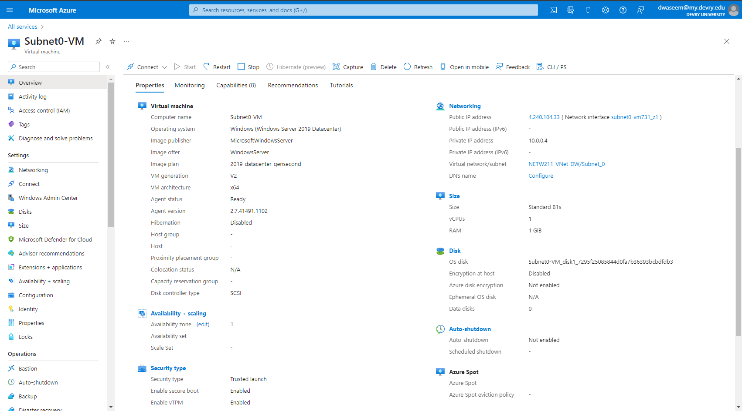
Deploying VMs into Subnets (1 of 3)
This screenshot includes the Properties section of the Subnet0-VM page, showing the networking and size information of the VM.

Slide 10
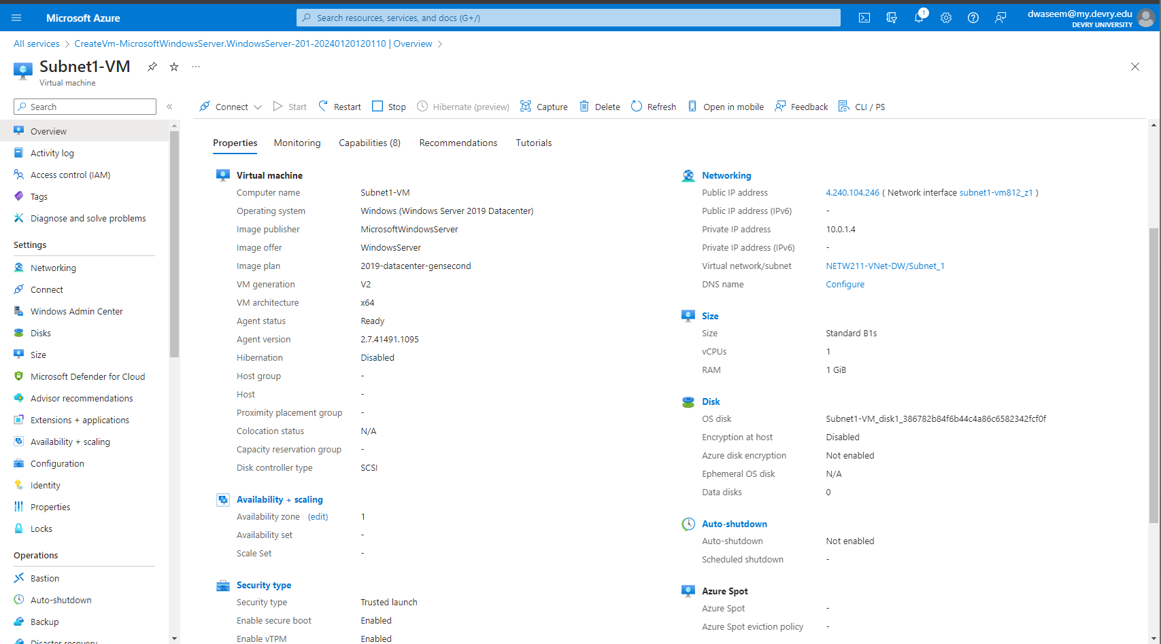
Deploying VMs into Subnets (2 of 3)
This screenshot includes the Properties section of the Subnet1-VM page, showing the networking and size information of the VM.

Slide 11
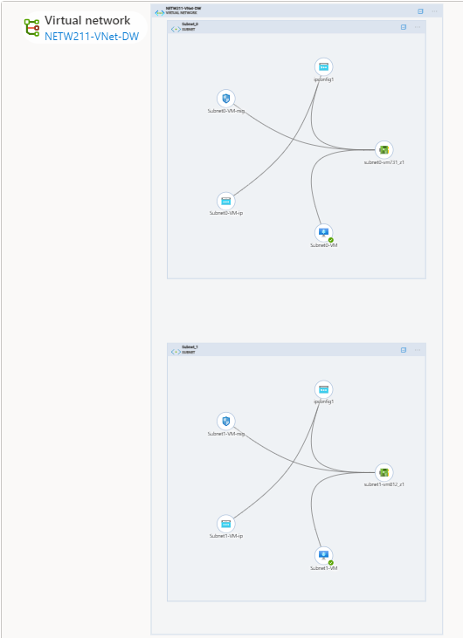
Deploying VMs into Subnets
(3 of 3)
This screenshot shows the topology diagram of my Vnet: (NETW211-VNet-DW with two subnets (Subnet0 and Subnet1) and one VM in each subnet (Subnet0-VM and Subnet1-VM).

Slide 12
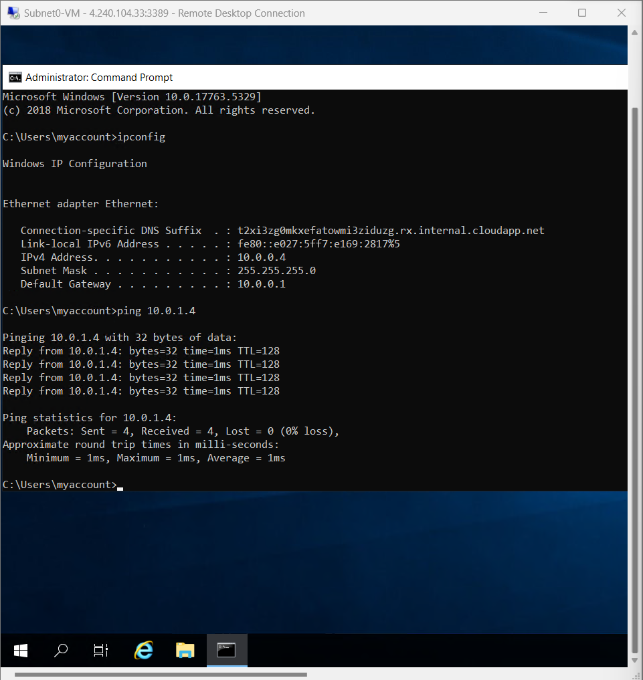
Verifying Connectivity between VMs
(1 of 2)
This screenshot shows:
The ipconfig and ping 10.0.1.4 results in the command prompt window of Subnet0-VM.
The ping is to Subnet1-VM.

Slide 13
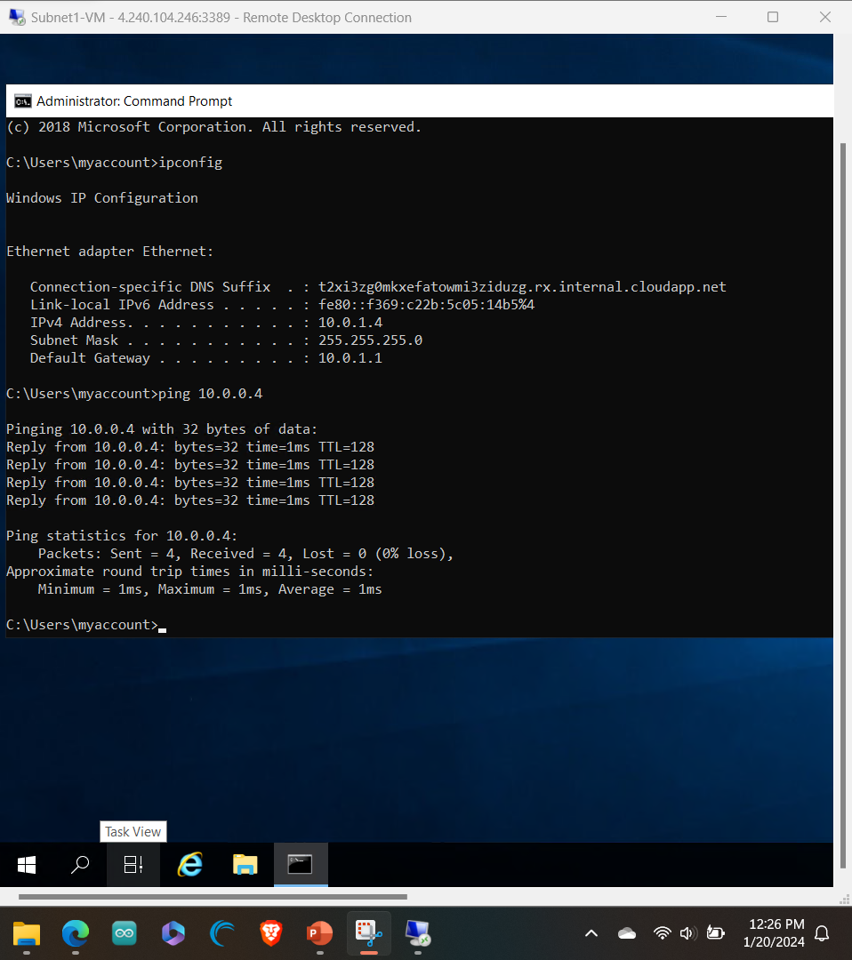
Verifying Connectivity between VMs
(2 of 2)
This screenshot shows:
The ipconfig and ping 10.0.0.4 results in the command prompt window of Subnet1-VM.
The ping is to Subnet0-VM.

Slide 14
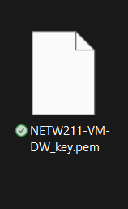
Azure VM Security
Launching a virtual machine calls for a secure connection. The slides coming up, will show the official launch into an Ubuntu Server VM. I’ll verify connectivity and will remote in via SSH by generating and using a key.pem file from a Windows local host machine command prompt. Once connected and verified the next step will show Network Security Groups to add a new rule in which allows us to ping the device when not remotely connected. Network security groups (NSG) utilize security rules to allow or deny inbound traffic in or any outbound network traffic from. Each rule can specify source and destination, port, and protocol. The NSG can be custom set to each VNet subnet and VM network interface and the same NSG can also be associated to as many subnets and NIC’s as the user chooses.

Slide 15
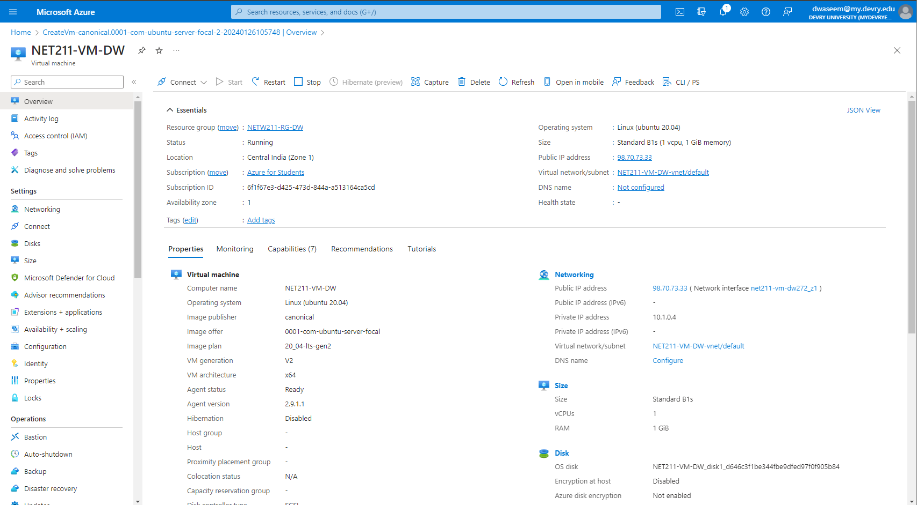
Launching a VM
This screenshot shows the NETW211-VM-DW, with resource group name, subscription, public IP address, and DVU email in the top right corner of the Azure Portal.

Slide 16
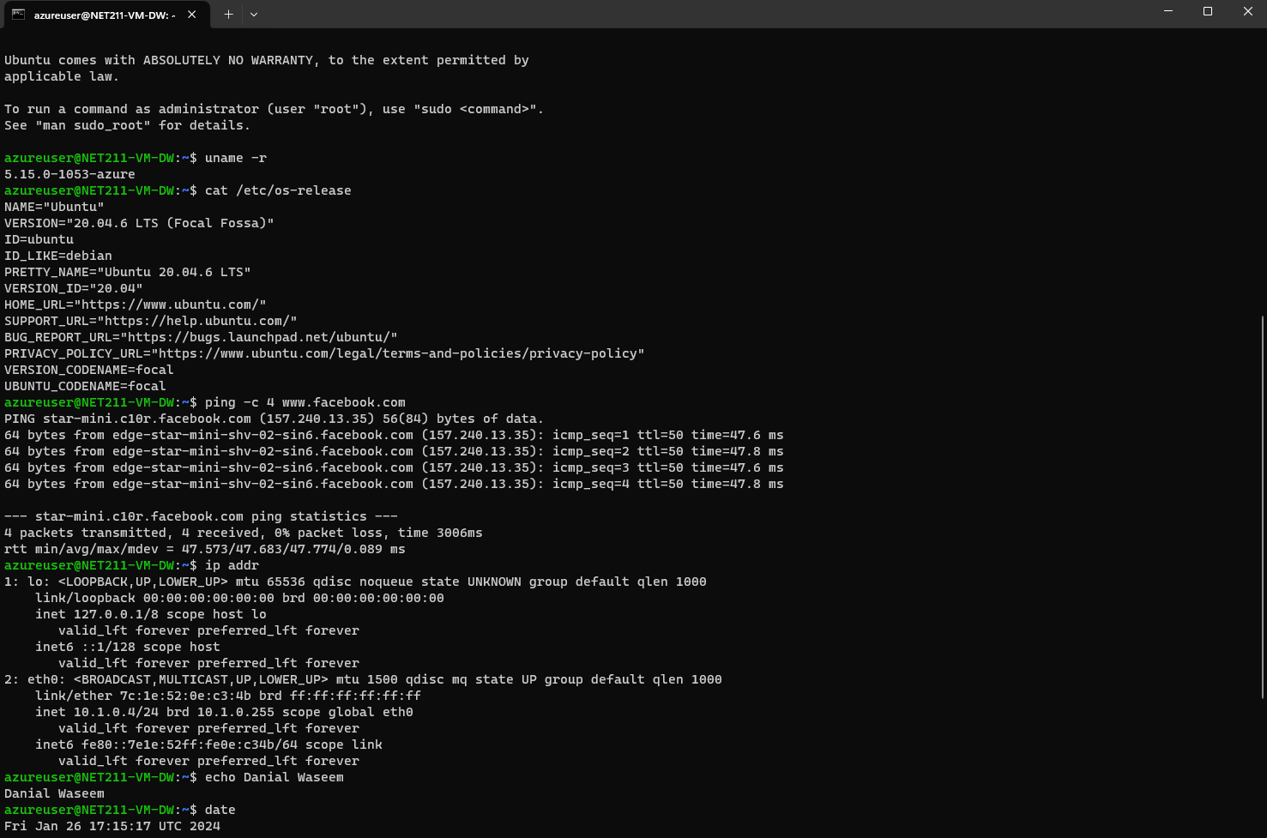
Connecting to the VM via SSH
This screenshot includes the azureuser@NETW211-VM-DW window showing the IPv4 address of the VM in the Azure cloud.

Slide 17
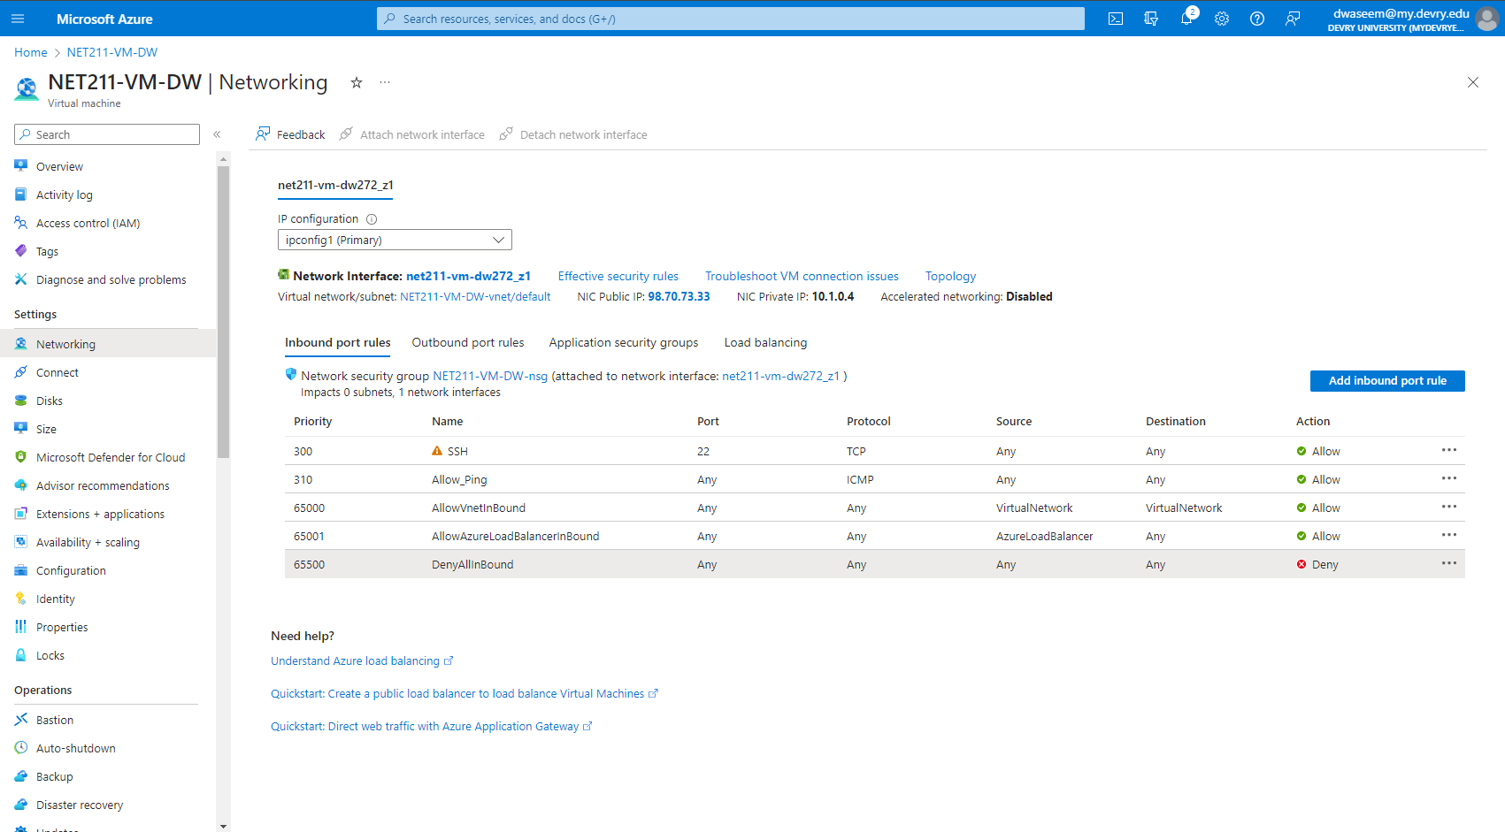
Configuring an NSG 1 of 2
This screenshot shows the Inbound port rules section with the newly added Allow_Ping rule.

Slide 18
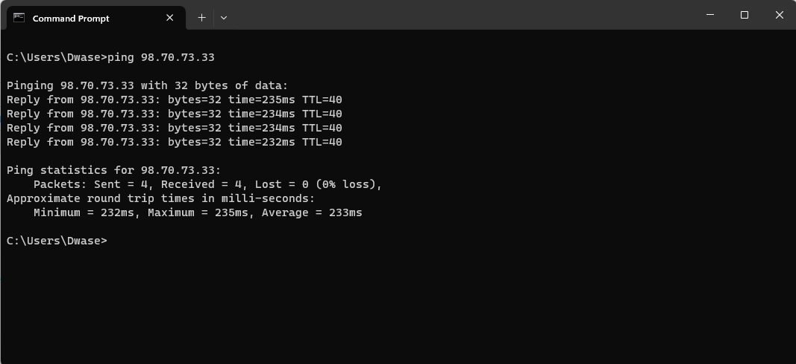
Configuring an NSG 2 of 2
This screenshot shows the successful ping result from my local host machine to the VM in the Azure cloud.

Slide 19
Cloud Storage
Data, images, files, audio, videos are a few forms of what needs to be stored in the cloud. Working with Azure’s Blob storage for object storage helps protect data for applications, websites, backups, IoT devices and big data analytics. I start by creating a storage account and a netw211container2137 container followed by the following upload:
.png image file
NETW211FILE.txt document
The properties for the container need public access to view because the snapshot has anonymous read access for Blobs only when viewing the .png image file in a browser window. After enabling access and confirming the accessibility level, we can create blob snapshots to allow a read-only copy that can now be viewed on a public browser. This .png file can also be promoted (reverted) back to, if we do not like the edited new version. We do this with the NETW211FILE.txt file by editing the original version that has a snapshot created to a new modified version. After viewing the modified version, we promote the snapshot and bring back the original. The last part of this Azure Blob section includes Enabling Blob Versioning. Versioning allows the user to edit and maintain versions of an object. In our case first revision, second revision and the original file. This applies to working with data within the Cloud and how we can save and create or go back to another version of the file. We keep the first revised version that is pictured coming up.

Slide 20
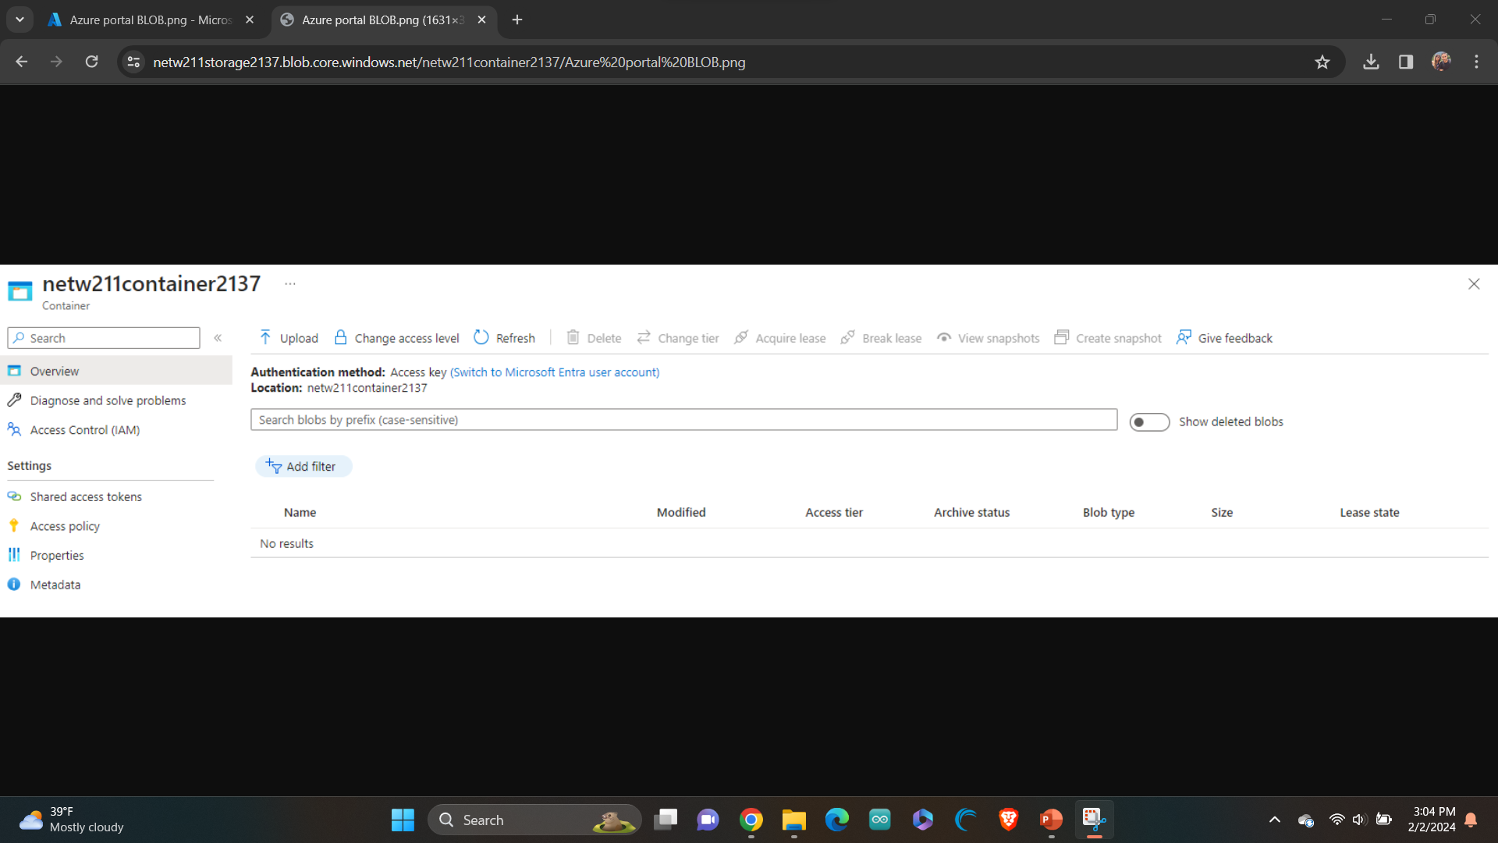
Uploading and Accessing a File
This screenshot shows the browser window with the image uploaded from my local host machine and the URL on top of the window.

Slide 21
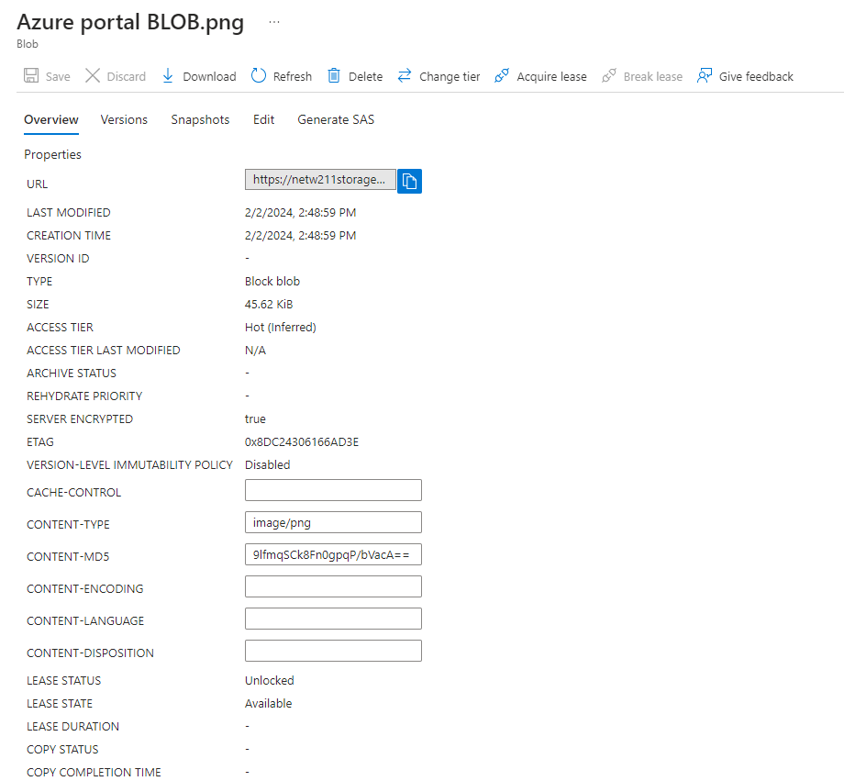
Uploading and Accessing a File
This screenshot shows the Last modified property of the uploaded image.

Slide 22
Creating Blob Snapshots 1 of 2
Additional info about access tiers and how storage works with Azure storage services. Access tiers setting allows the user to set up what tier the data should be stored on.
Azure Blob storage Access tiers include:
Hot Tier – This data is accessed or modified frequently; this has the highest cost. (Where I am storing data in).
Cool Tier – This data is infrequently accessed or modified; data stored here should be stored minimum 30 days.
Cold Tier – Data stored here is rarely accessed or modified; minimum storage of 90 days.
Archive Tier – Also rarely accessed, minimum of 180 days before archiving.

Slide 23
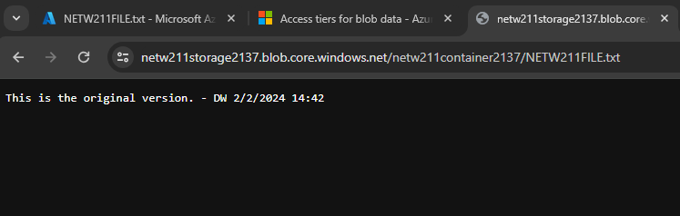
Creating Blob Snapshots
2 of 2
This screenshot shows the browser window with the “This is the original version. –DW” message and the URL on top of the window.

Slide 24
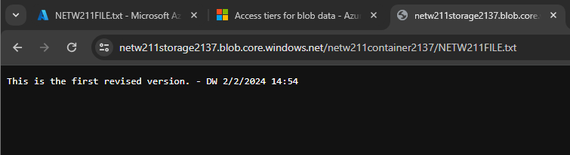
Enabling Blob Versioning
This screenshot shows the browser window with; “This is the first revised version. –DW” message and the URL on top of the window.

Slide 25
Cloud Monitoring
Cloud monitoring is the final segment which introduces the setting up of Actions Groups and notification alerts within the Azure cloud platform. By setting up a resource group named NET211-RG-DW2137 we can assign the new Action group called VM-Status-Change that displays VM-Status and sends out an alert to my email for preselected Alert Rules such as VM-Restart and VM-Deallocation. This is done after creating our Ubuntu Server virtual machine (VM) by setting conditions for our alert rules with the signals named Restart Virtual Machines and Deallocate Virtual Machines.
When a user goes to restart their VM an alert is sent to the administrator. Once the user is done with their system the administrator again is alerted that the VM has been stopped or deallocated.
The simulation that I created here utilizes Azure Monitor services that collect metrics and activity logs. This is a collection of data by Azure on user activity that can be catered to automizing processes, maintaining resources and correcting any errors that come up by troubleshooting those errors. The action groups are a collection of notification preferences that alert the Administrator when triggered by the preferences set.

Slide 26
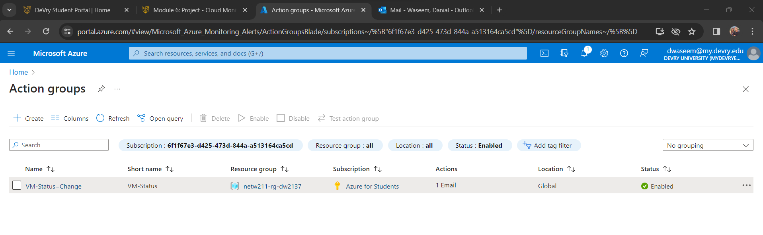
Setting up an Action Group and Notifications
This screenshot shows the “VM-Status-Change” action group on the Manage actions page.
This screenshot also shows my DVU email in the top right corner of the Azure Portal.

Slide 27
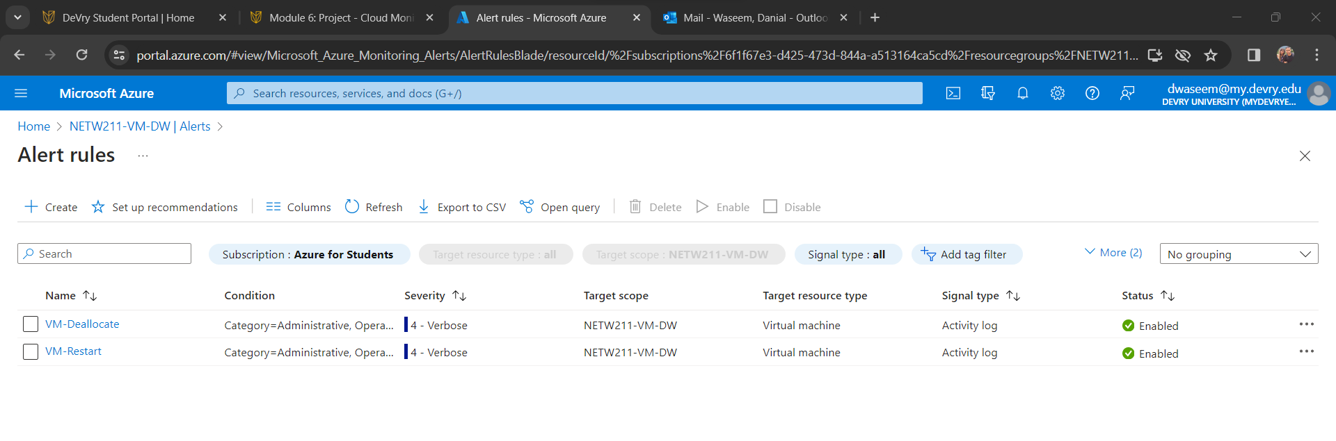
Setting up Alert Rules
This screenshot shows the Alert rules window showing the VM-Deallocate and VM-Restart rules.
This screenshot also shows my DVU email in the top right corner of the Azure Portal.

Slide 28
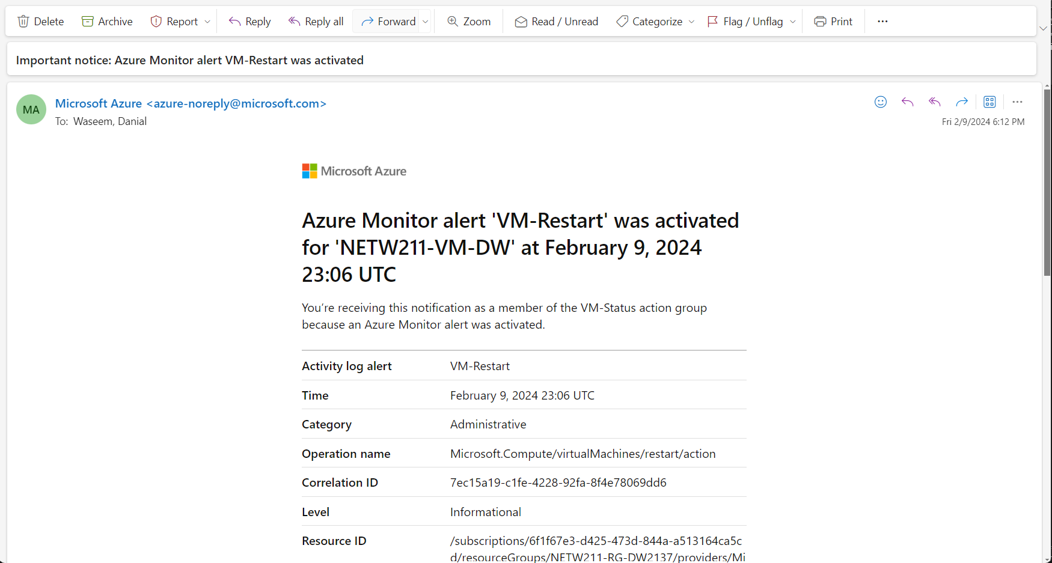
Testing Alerts: 1 of 2
This screenshot shows the ‘VM-Restart’ was activated email message with the date and time of the alert.

Slide 29
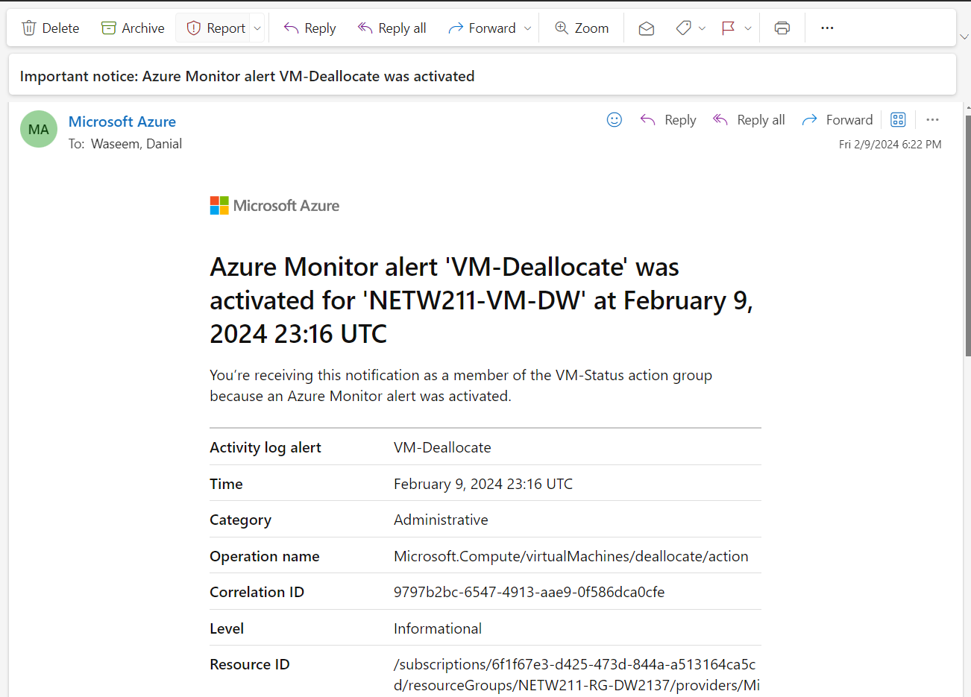
Testing Alerts 2 of 2
This screenshot shows the ‘VM-Deallocate’ was activated email message with the date and time of the alert.

Slide 30
Challenges
The VM instance I chose have low specifications and due to lower bandwidth, storage space and IOPs (input outputs per second) this instance runs very slow and can present challenging.
The Azure platform is one with complex features that can be challenging to navigate and set up correctly.
The virtual private networks each need careful administering of correct addressing. When deploying the correct prefix of addresses /24, /16 the administrator must know the correct subnetting techniques.
While working through the Secure SSH remote session, I did have to start over and delete my first resource group launch because of a password not being accepted. After making a new group, and password and launching a VM I still had difficulty with the remote session not connecting, however, after entering the command in again I noticed a script error, corrected the error, and connected securely to my VM.
The tricky parts of working with versioning are enabling permissions for anonymous public viewing. This also shows that we must be aware of how we partition and configure our data if data confidentiality, integrity, and availability is a goal.
Although Cloud monitoring was a simulation and the main technical challenge, I found is the latency between VM being restarted or deallocated. If there was a security breach involved, the latency period can be posed as a security risk.
Another challenge I found is the order of operations from Action Group, to Action Rule and then setting the VM condition to activate to the assigned group.

Slide 31

Career skills
Cloud deployment & virtualization
VNET Configuring and management
Monitoring infrastructure and troubleshooting
IP addressing and Database management
Cloud security including security controls
Cloud storage management, including data migration and automation
Alert Configuration

Slide 32
Conclusion
As cloud computing continues to gain widespread adoption, gaining hands-on experience within cloud environments is a skill developed with practice. According to Check Point, “Security misconfiguration are one of the leading causes of cloud data breaches.” Check point shows Misconfiguration as the number one threat against cloud solutions.
This project provides my comprehensive exploration of Microsoft Azure’s cloud services, focusing on key functionalities and practical applications such as VM instance management within resource groups. The VMs are versatile, managing multiple resources with a single group. Subnetting, remote SSH connections, and network security groups emphasize the importance of proper configuration and encryption for secure access. Image and document uploads demonstrate a practical approach to snapshots and versions. By, implementing proactive monitoring through alert rules, users can enhance security and responsiveness in managing cloud infrastructure. Overall, the hands-on experience gained in cloud administration is essential for following best practices for secure and efficient cloud deployment.

Slide 33
references
West, J. (2021). CompTIA® Cloud+ Guide to Cloud Computing (1st ed.). Cengage.
(2023, August 31). Azure Virtual Network FAQ. Azure Virtual Network FAQ | Microsoft Learn. https://learn.microsoft.com/en-us/azure/virtual-network/virtual-networks-faq
Kerner, S. M., & Davis, E. (2024, January 5). Top 24 cloud computing skills to boost your career in 2024. WhatIs. https://www.techtarget.com/whatis/feature/Top-20-cloud-computing-skills-to-boost-your-career
Rboucher. (2024, February 5). Azure Monitor Overview - Azure Monitor. Azure Monitor | Microsoft Learn. https://learn.microsoft.com/en-us/azure/azure-monitor/overview
The FTC Office of Technology. (2023, March 22). An inquiry into Cloud Computing Business Practices: The Federal Trade Commission is seeking public comments. Federal Trade Commission. https://www.ftc.gov/policy/advocacy-research/tech-at-ftc/2023/03/inquiry-cloud-computing-business-practices-federal-trade-commission-seeking-public-comments
Check Point Software. (2023, December 7). Top 7 cloud vulnerabilities in 2024. Check Point Software. https://www.checkpoint.com/cyber-hub/cloud-security/what-is-cloud-security/top-7-cloud-vulnerabilities-in-2024/
https://azure.microsoft.com/en-us/free/students/

