Slide 1

Provisioning cybersecurity
Encryption, Firewall rules, Policy, and Vulnerability Assessment.
By: Danial Waseem
Administrating Professor: Rexford Okrah
SEC285 Fundamentals of Information Security

Slide 2
Introduction
Cybersecurity threats and data breaches are inventible parts of our digital landscape. Our role as cybersecurity professionals is to work towards reducing their impact through mitigation, monitoring, and proactive prevention strategies.
Recent statistics from statista.com clarifies the need for thwarting attacks, noting that the U.S. alone in 2023, had 3,205 data compromise incidents that affected 353 million individuals.
The techniques and tools explored in this project provide a practical approach to actively manage, monitor, and counteract such security incidents.
The following tools and services are applied :
  Asymmetric key encryption
  Stateful firewall implementation and Nmap scans
  BYOD Policy
  Multifactor Authentication (MFA)
  Vulnerability Assessment

Slide 3

Asymmetric Key Encryption
A cryptographic system utilizes a pair of keys. One is a public key which can be shared openly, and one is a private key, which is kept secret by the owner. Data encrypted with the public key can only be decrypted with the private key which facilitates secure communication and data exchange.
The process shown in Kali Linux includes an open-source tool called GNU privacy guard (GPG) that has pretty good privacy (PGP) standard and outputs a pair of public and private keys with a passphrase to encrypt and decrypt my files.
I create a testfile.txt and encrypt the file with GPG, depicted in the next slide and later is decrypted using my passphrase.
Finally, the original plaintext file after encryption is deleted by the shred command with options to overwrite 30 times, truncate and remove after overwriting and adding a final overwrite with zeros to hide shredding.

Slide 4
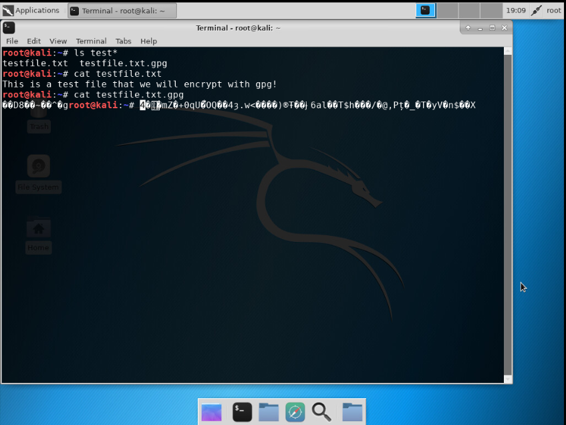
File Encryption
This screenshot shows the following.
Content of the plaintext file
Content of the encrypted file

Slide 5
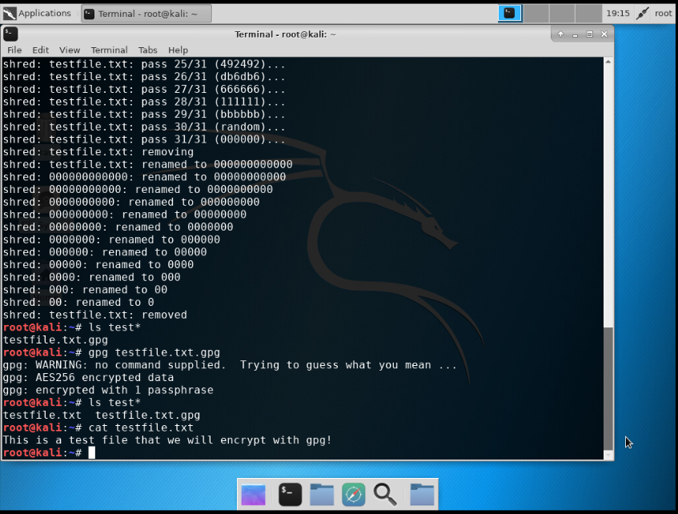
File Decryption
This screenshot shows the following.
The encrypted file being listed by itself
The decrypting process
Both the encrypted file and the original plaintext file being listed

Slide 6
Stateful Firewall
A firewall protects an enterprise with computing resources from attacks.
Servers or computers can be hardened by setting up the stateful firewall rules with iptables. I will be working with a Linux server virtual machine. First step is to check and verify open ports by utilizing Nmap pipe more which scans for all open ports.
Next, I can go through and enter sudo iptables –policy INPUT DROP to set the default policy for the input chain to drop if incoming packets do not match any other rules.
I then set up to flush specified chains in the iptables firewall. Followed by adding the following rules:
Invalid packets to the server are dropped
All incoming and outgoing traffic is forwarded on the loopback interface
Accept all packets in an established TCP connection
Accept SSH sessions
Accept incoming ICMP packets
Support identified services in the IP policy tables
Allow locally generated packets to be forwarded
Save all rules to persist after any reboots

Slide 7
Benefits
The command sudo iptables --policy INPUT DROP sets default policy of the INPUT chain to drop and prevent all incoming traffic. This allows the administrator to set rules for specific ports to be open and set up firewall rules for those specific ports on the Linux Server VM by using packet filtering.
The rules implemented are displayed on the next slide with a Nmap | more scan to show results with 995 ports as filtered which significantly reduces open ports.

Slide 8
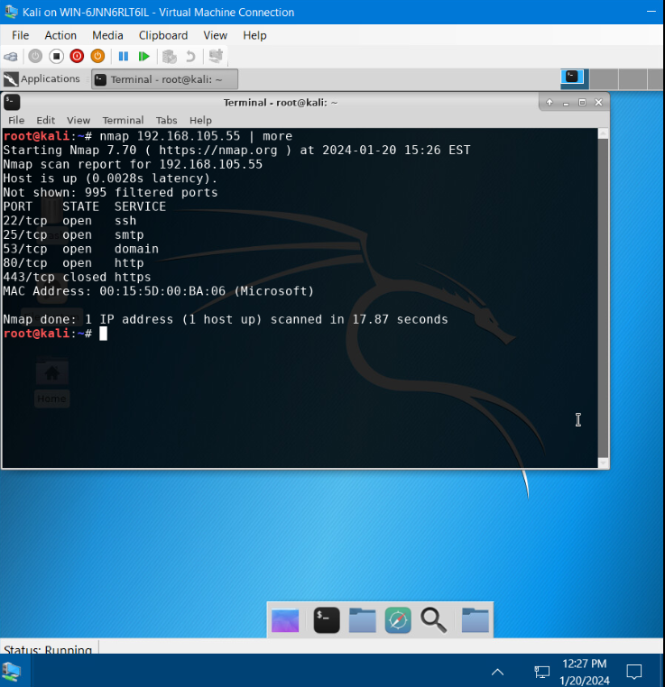
Nmap Scan
This screenshot shows the Nmap scan result of the Linux Server VM.

Slide 9
Bring your own device security Policy
At this phase of the project, I create a BYOD policy for a fictitious company named ABC Corporation. A BYOD policy allows users to use their own personal mobile devices for business purposes with respect to security in mind, the following slides showcase the BYOD policy draft.
Benefits for enterprises include:
Management flexibility
Less oversight
Cost savings
Increased employee performance
Simplified IT infrastructure
Reduced internal service
Benefits for Users:
Choice of device
Choice of carrier
Convenience

Slide 10
Overview:
When completing a daily task such as grocery shopping, home delivery, working from home or working in the office, the common denominator is connected device. According to Data Reportal “trends suggest that two-thirds of the worlds population should be online by the middle of 2024.” The worlds internet users includes “95% using a mobile phone to go online and mobile phones now account for roughly 57% of our online time, 53% of the worlds web traffic.” “6 in 10 internet users in the world’s larger economies still use laptops and desktops for at least some of their online activities.” With a growing number of devices available to users, an increasing risk for devices being lost, compromised, and or stolen by a thief outside of an enterprise requires data security. Mobile devices can also allow location tracking thereby increasing risk of targeted physical attacks. Often users may tether a mobile device to connect to a network without securing on a corporate network. Users are at risk of phishing emails that contain malware with payloads spreading worms that traverse an enterprise network laying dormant but collecting data. The same malware can be coupled with a virus to spread with user access who is connected to an enterprise network via personal laptop. This virus can spread by way of accessing various types of files. Various methods of network poisoning through add-ons and plug ins on browsers all pose risk and further ease for a threat actor to infect a modern enterprise.
Purpose:
The goal of this policy is to protect confidentiality, integrity, and availability (CIA) of data. BYOD Policy applies to ABC Corporation employees, faculty, and staff and any users utilizing network and computing resources provided by enterprises or their employees, faculty, staff and any users. Identifying vulnerabilities and risks early on, can prevent potential breaches, data leakage (intentional or accidental), reducing unauthorized access to sensitive information. Following procedure and policy mitigates malware spread across an enterprise network protecting both users, organizational data, and personally identifiable information. Implementing a BYOD policy will reduce the overall attack vector creating additional barriers for attackers to exploit resources. Further, minimizing risks associated with BYOD calls for maintaining compliance with regulatory requirements and ensuring business continuity.

Slide 11
Scope:
Personally owned devices applies to the following:
Portable computers such as laptops, notebooks, hybrid devices
Portable storage media such as USB storage devices, flash memory cards, CD/DVD ROMs
Mobile devices including cellular smart phones, tablet computers
Devices entering an ABC Corporation pose risk of loss, threat, copyright, malware and require compliance of regulatory practices.
Any privately owned wireless or portable handheld devices referred to as BYOD requires permission from ABC Corporation’s IT Security Team that allows the usage of devices at work. Permissions must be granted by the IT Security Team for any device that is entering or exiting the enterprise. These devices must be listed on the departments list of approved mobile devices. All employees, staff and users within the network will receive formal approval for such devices. Some technical limitations are imposed based on what device is being utilized. Approved devices must adhere to company/enterprise approved methods of encryption with respect to secure data management procedures. Data may not be accessed on any other hardware that fails to meet approved security standards. With correct methods in place a user may access work emails, documents, approved remote work, communication and collaboration applications such as Teams, Zoom, and Slack. Approved research and information gathering, task and project management on approved applications. All data must be secured with secure encrypted channels, physical on premises or cloud-based storage. Discretionary limits are imposed on personal browsing and must not interfere with work responsibilities and security protocols.

Slide 12
Policy:
All faculty, staff, and users of ABC Corporation’s network must adhere by this policy while using personally owned devices. Additional policies in relation to BYOD policy include:
Acceptable Use Policy
Data Policy
Bandwidth policy
Participants of this BYOD policy must meet the correct Operating System Requirements, include the required Antivirus Software, and Firewall rules. Devices must have full-disk encryption standards protecting company stored data. Enabled and secured Wi-Fi settings with trusted WPA2-AES encryption. If required, an approved VPN for work outside of the enterprise connecting to network resources. Devices must include a lock out mechanism with an ability to lockout if authentication and authorization fail. Enable two-factor authentication accessing all corporate resources. Regular backup of work-related data by secured approved methods must be implemented. If devices are compromised or non-compliant, the user or employee must notify the IT Security department. Non-compliant devices can be issued limited access. All employees, staff and faculty are responsible for their BYOD with some support from the IT Security department for remediation.

Slide 13
Policy Compliance:
The IT Security team maintains the primary responsibility of verifying compliance to this policy. The methods of verification include software updates and periodic checks for antivirus, firewall, IDS/IPS, device and network audits, user access logs, event trackers, NAC, remote scanning tools such as Microsoft Intune, encryption verification, and signed policy acknowledgement of receiving this policy after awareness and training.
Any employees and users found to have violated this policy, based on the IT Security team management, may be subject to:
Warning and education with mandatory compliance training,
Temporary restrictions or revoked privileges,
Financial penalties and liability damages.
Serious offenses can lead to permanent expulsion and termination of employment and legal action.
Related Standards, Policies, and Processes:
ABC Corporation departments with healthcare information must abide by HIPAA standards. HIPAA provides privacy and safeguarding the C.I.A. of Protected Health Information (PHI).
Other policies include:
Acceptable Use Policy – Rules and guidelines to specify how users are permitted to use company provided IT resources, including network access, computer equipment. Safe, ethical and legal use outline what is acceptable and what is prohibited behaviors.
Data Policy – Governing set of guidelines and practices that govern the collection, handling, storage, and dissemination of data within an organization.
Bandwidth policy – How network bandwidth is allocated, prioritized, and controlled to maintain efficient and fair usage among all users and services within the organizations.

Slide 14
Definitions and Terms:
Confidentiality, Integrity, Availability – the CIA triad, Confidentiality refers to protecting information from unauthorized access. Integrity means that the data secured is trustworthy, complete, and has not been tampered or altered and modified by an unauthorized user. Availability means that data is accessible when needed.
HIPAA – Health Insurance Portability and Accountability act. HIPAA ensures that the privacy rule is implemented and assures individuals’ health information is securely protected.
PHI – Protected Health Information
Mobile Devices: Include Mobile operating systems, wireless NIC and other USB plug in devices, smartphones, tablets, laptops, wearable technology, and portable computers. Additional devices can include
Revision History:
Date of change | Responsible | Summary of change
January 2023 | ABC Corporation IT Security team | Implementing new BYOD Policy

Slide 15
Multifactor authentication (mfa)
MFA is achieved with the use of more than one type of authentication credential.
For example: Signing into a portal or banking web application that requires login credentials and a pin that is sent by text to the user's cell phone.
Showcasing the next steps, I implement MFA by adding a time-based one-time password (OTP) to the authentication process.
The well-known single sign-on (SSO) process is easier for a user, however, opens doors for an attacker to compromise the process. I can mitigate this risk by applying MFA via Google Authenticator app which refreshes with a new OTP every thirty seconds.
Google Authenticator is set up on my Ubuntu virtual machine terminal window to display a QR code that syncs with the Google Authenticator app on my personal cell phone
This achieves a more secured sign on process by proactively preventing easier access.

Slide 16
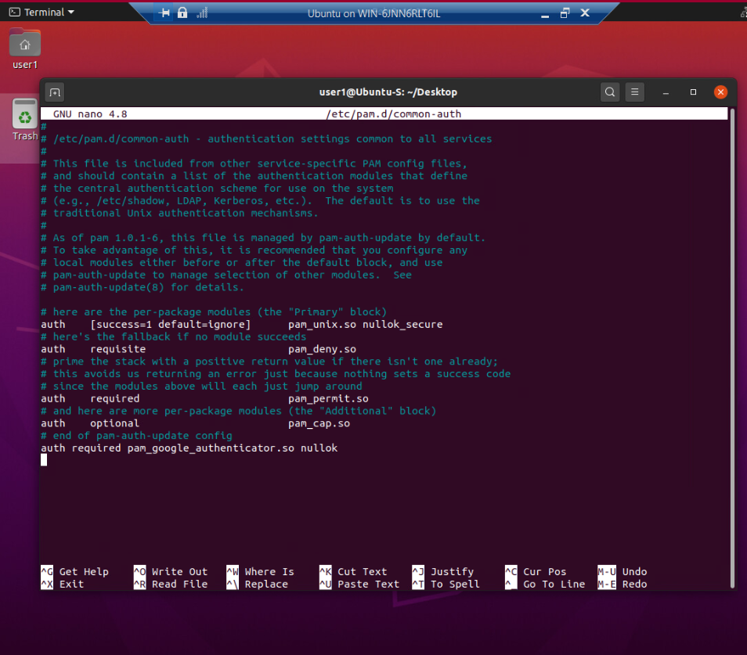
Common-auth Configuration File
This screenshot shows the entry that indicates the use of the Google Authenticator module.

Slide 17
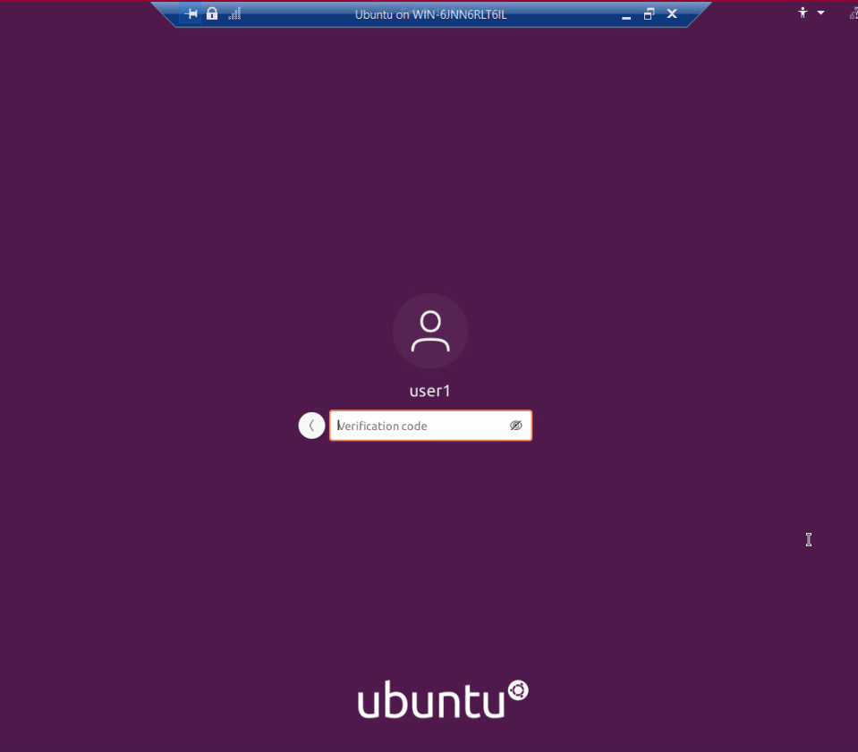
MFA Logon Screen
This screenshot shows the logon screen where a verification code is required.

Slide 18
Vulnerability assessment
The final portion of this project includes assessment of a server on a Kali VM by using the following tools:
Nmap
Netcat
Wireshark
Vulnerability Assessment is a systematic and methodical evaluation of the security posture of the enterprise. The assessment examines asset exposure to attackers, forces of nature, and any other entity that could cause harm. The focus is on:
Asset identification
Threat Evaluation
Vulnerability Appraisal
Risk assessment
Risk mitigation

Slide 19
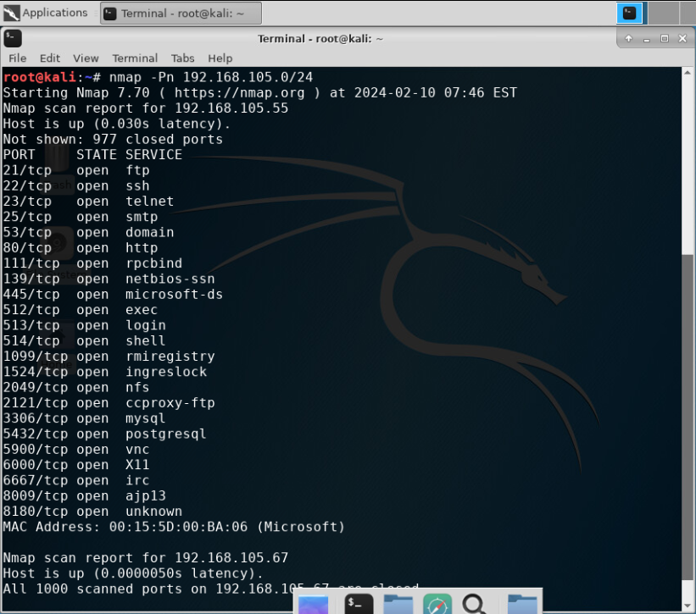
Nmap
This screenshot includes the scan result showing the Kali VM and its open ports on subnets 192.168.105.0/24.
Showing 192.168.105.67 with all 1000 ports as closed.

Slide 20
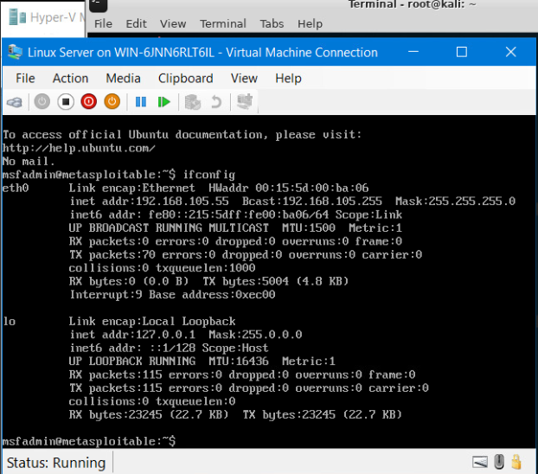
Nmap
This screenshot includes the Nmap scan result showing Linux Server VMs.

Slide 21
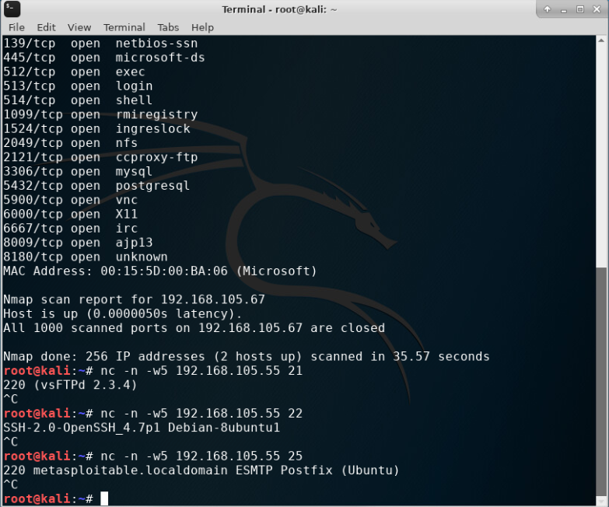
Netcat
This screenshot includes the scan result showing the Kali VM.
Output shows:
vsFTP 2.3.4
OpenSSH 4.7 Debain Ubuntu
SMTP Postfix
These can be vulnerable ports found with the Nmap scan. Grabbing the banner and knowing the version helps determining if any vulnerabilities exist

Slide 22
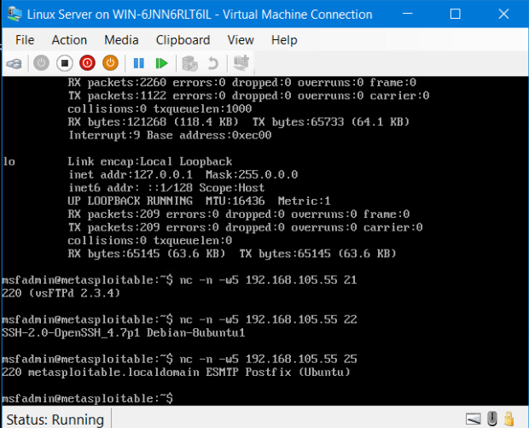
Netcat
This screenshot includes the NetCat scan from Linux Server.
The output shows:
vsFTP 2.3.4
OpenSSH 4.7 Debian Ubuntu
ESMTP Postfix

Slide 23
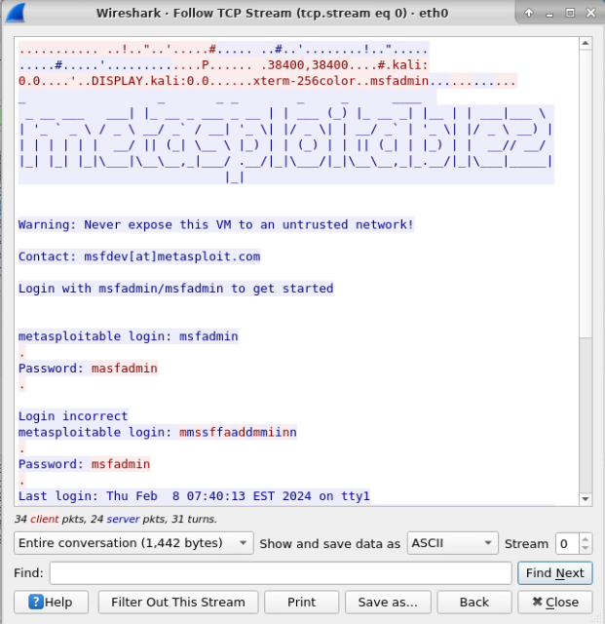
Wireshark
This screenshot includes the Wireshark—Follow TCP Steam window showing the Telnet username and password.
Wireshark is a packet sniffing tool that can analyze network traffic for insight into client and server applications.
By finding the Telnet data packet and following the TCP stream, I was able to obtain the login credentials.

Slide 24
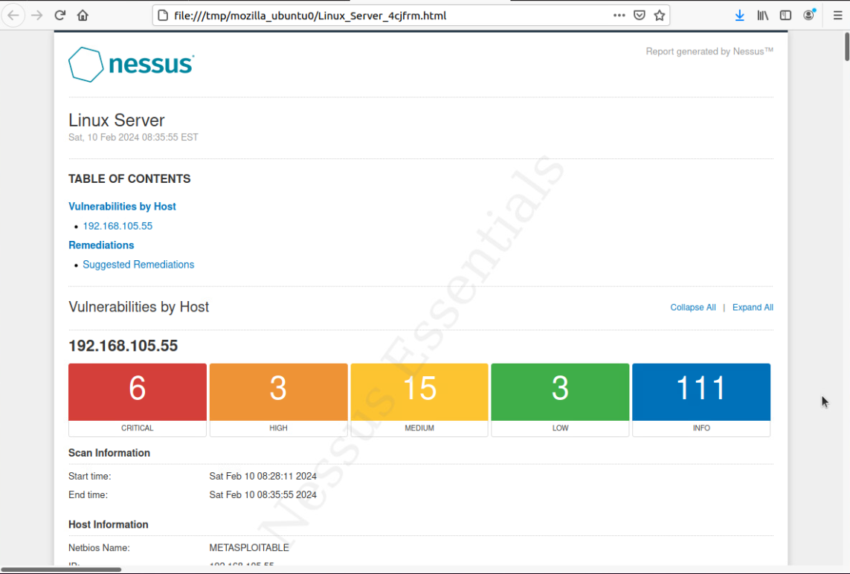
Nessus
This screenshot includes the high-level view of the Nessus vulnerability scan report generated and showing categories of vulnerabilities in different colors.

Slide 25

Challenges
Setting up iptables with GNU require a deep understanding of the commands and options on Linux that follow each command. The commands entered require an order or process that needs to be followed prior to setting up each rule to being filtered. This is a complex process when setting up correctly.
Banner grabbing process during a vulnerability assessment requires knowledge of what you are looking for. For example, if it is SSH, after completing Nmap to find the port open, Netcat to find its version, I found that I need to also know if that version is exploitable. In my case following the Telnet data stream on Wireshark opened the login credentials.

Slide 26

Career Skills
Firewall Configuration and Management
Network Security Analysis
Security Policy Development
Access Control Implementation
Security Auditing
Risk Assessment
Risk Mitigation
Incident Response planning
Compliance Management
Data Protection and Privacy
Vulnerability Assessment

Slide 27

Conclusion
The tools and strategies applied through out this project including asymmetric key encryption to stateful firewalls, and vulnerability assessments are the tip of a growing solution. With cyber threats and data breaches on the rise, defenses, knowledge, and mitigation can prevent further damage from occurring with an expected rule of thumb. By implementing MFA, BYOD policies we can establish layers against vulnerabilities of an increasingly connected world. The learning from these practical application of cybersecurity, serve as a guidance to safeguard valuable digital assets against the inevitability of cyber threats.

Slide 28
References
Ciampa, M. D. (2018). Comptia security+: Guide to Network Security Fundamentals (6th ed.). Cengage.
Published by Ani Petrosyan, & 12, F. (2024, February 12). Number of data breaches and victims U.S. 2023. Statista. https://www.statista.com/statistics/273550/data-breaches-recorded-in-the-united-states-by-number-of-breaches-and-records-exposed/
Sobers, R. (2024, January 4). 161 cybersecurity statistics and trends [updated 2023]. Varonis. https://www.varonis.com/blog/cybersecurity-statistics
Cengage. (n.d.). Infosec learning Labs. Asymmetric Key Encryption, Stateful Firewall, Multi Factor Authentication, Vulnerability assessment. https://lab.infoseclearning.com/course/BPUUGYUWOV/lab/CQOOKAWDJO?check_logged_in=1
SANS. Bring Your Own Device (BYOD) Security Policy. (2019). Retrieved February 15, 2024.

