Slide 1
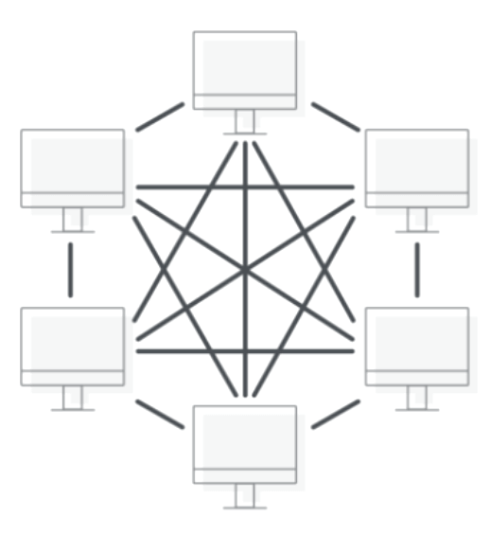
Network 191 Infrastructure Showcase
Presentation: Danial Waseem
Administering Professor: Farooq Afzal

Slide 2
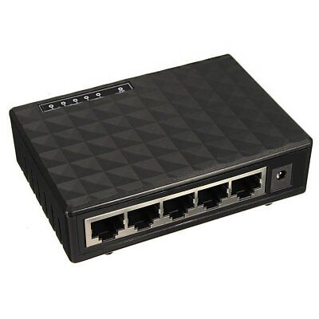
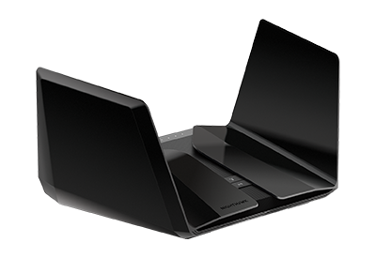
Overview
Introduction
IPv4 Addressing
Connectivity Testing
IP Subnetting and Loopback Interfaces
Visio Diagram Network Topology
SOHO Wireless Networking Security
Challenges
Skills & Growth
Summary
References
This Photo by Unknown Author is licensed under CC BY-NC-ND
This Photo by Unknown Author is licensed under CC BY-SA

Slide 3
Introduction
The Network 191 course emphasizes the significance of network management and connectivity within the small home office (SOHO) router network and beyond into larger enterprise networks.
We use a Hyper-V with Ubuntu virtual machines throughout this project.
The importance in learning about DHCP servers or by static addressing with correct configuration, route assignments, segmenting, subnetting, and testing network connectivity between multiple virtual machines. Successful pinging between machines alongside a network topology diagram illustrate a successful connection.
Practicing with a TP-Link router emulator furthers understanding of security requirements such as WPA2-PSK AES encryption or MAC Filtering. While challenges lie ahead, the career skills gained outweigh the complexities of networking.

Slide 4
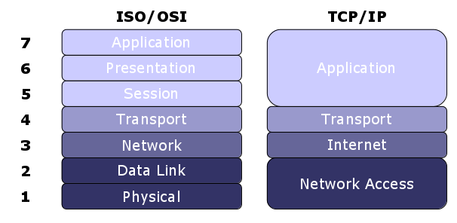
IPv4 Addressing
By accessing our SOHO router and by grabbing the IP address from our Ubuntu command shell terminal on our virtual machine we enter the IP into our web browser and access the gateway settings.
Next, we change the static IP address from 192.168.1.1 to our new IP 192.168.105.1/24 apply these changes and through our Ubuntu shell terminal we power down our network and power it back up to refresh the configuration and now can verify that the IP address change was successful.
We also then proceed to verify the gateway settings were configured by logging in to the gateway with the new IP address in our web browser.
This Photo by Unknown Author is licensed under CC BY-SA

Slide 5
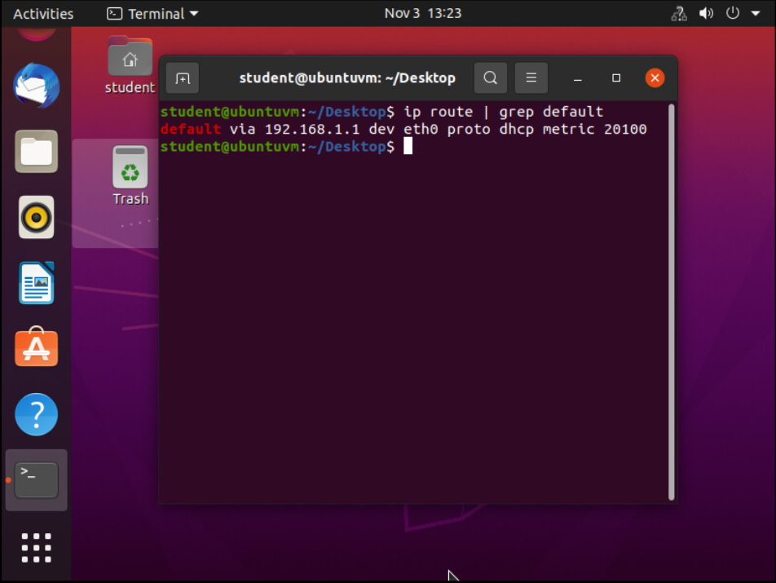
IPv4 Addressing
Assigning IP addresses to support our small home office router network. By using the Hyper-V software for our Ubuntu virtual machine, we can administer an IP addresses to our SOHO router. By default, our router is set by a DHCP server.
Screenshot of the terminal window with the default gateway IP address.

Slide 6
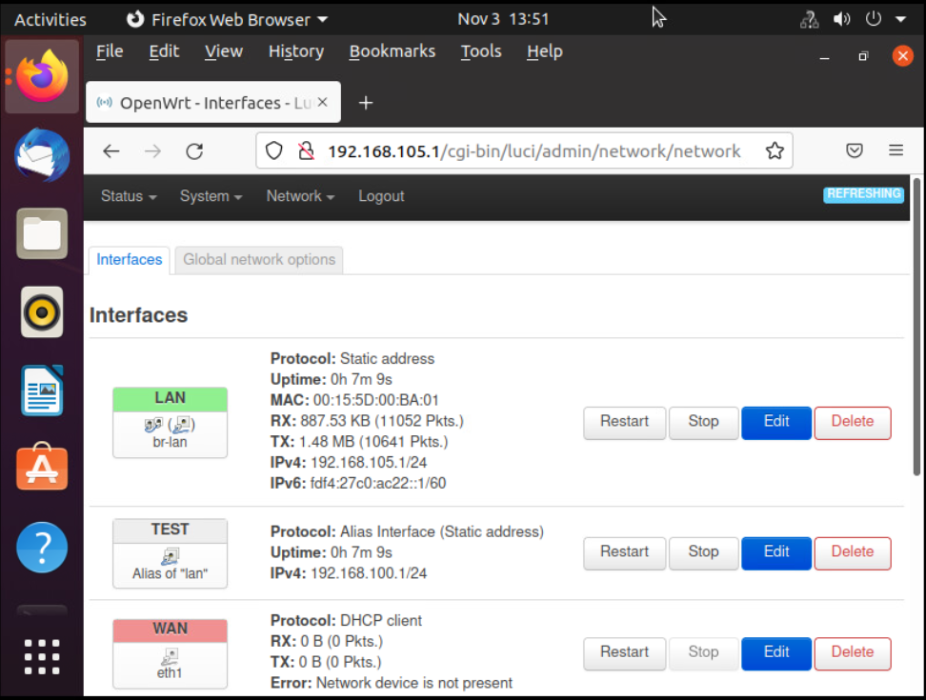
IPv4 Address Assignment
The Interfaces page with the new IPv4 address on the LAN interface.

Slide 7
Connectivity Testing
The next objective is to ping our SOHO router within the terminal on Ubuntu Computer 1 and to Ubuntu Computer 2. Next step is to test the connectivity from Ubuntu Computer 2 terminal to the SOHO Router and to Ubuntu Computer 1.
The following screenshots display three IP addresses:
SOHO Router: 192.168.105.1
Ubuntu Computer 1: 192.168.105.228
Ubuntu Computer 2: 192.168.105.230

Slide 8
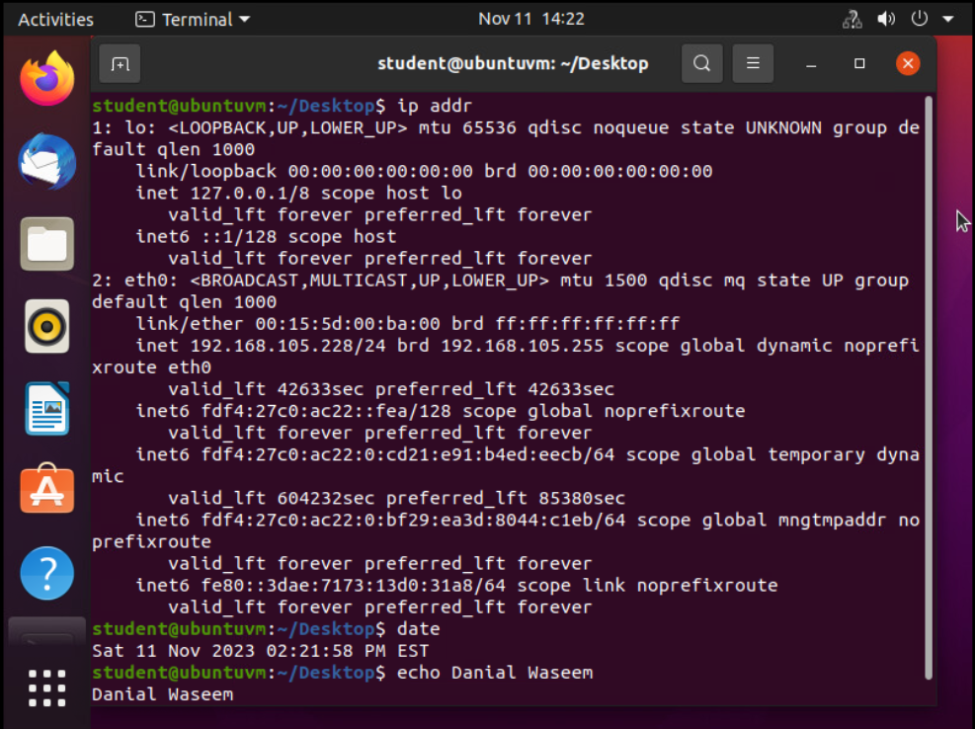
Dynamic IP Address Assignment
Terminal window. IPv4 address of the Computer 1 VM.

Slide 9
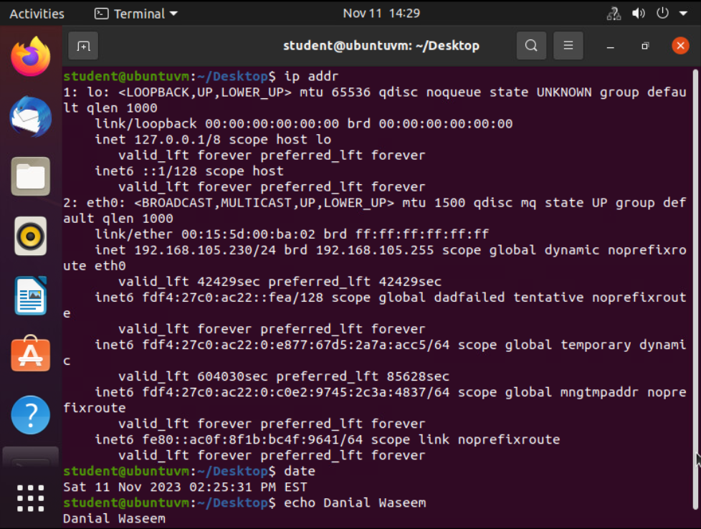
Dynamic IP Address Assignment
Terminal window of IPv4 address for Computer 2 virtual machine.

Slide 10
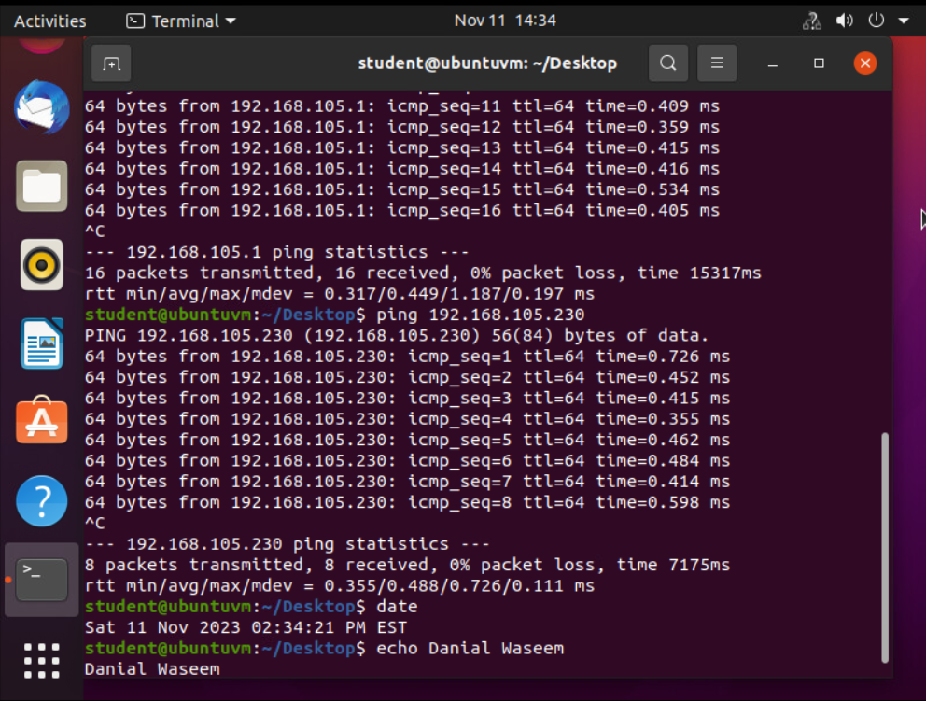
Connectivity Test
Connectivity test from Computer 1 to SOHO Router.
Connectivity test from the Computer 1 to Computer 2.

Slide 11
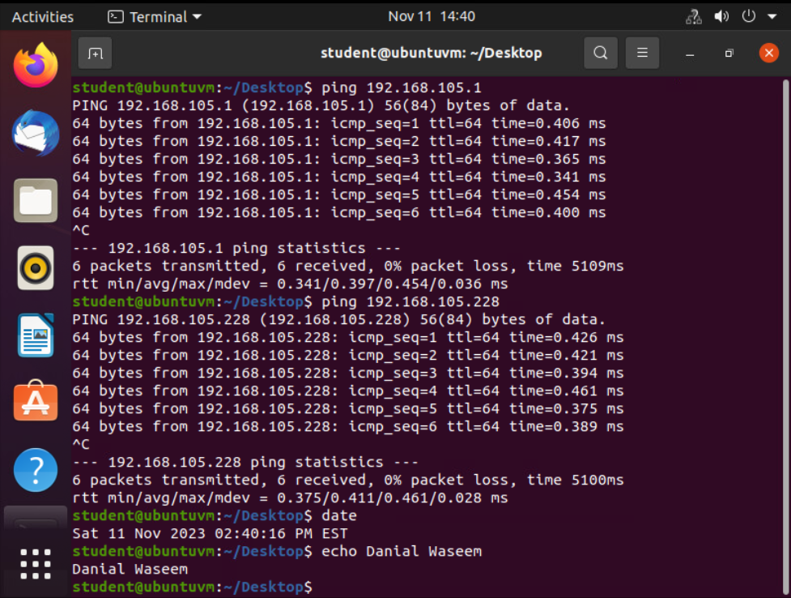
Connectivity Test
Connectivity test from Computer 2 to SOHO Router.
Connectivity test from Computer 2 to Computer 1.

Slide 12
The network connection on the SOHO Router proved successful with Computer 1 and Computer 2.
All three devices successfully communicate with the SOHO router and with each other.
By identifying the protocol for ETH0 as inet, the IP address of the SOHO Router, Computer 1, and Computer 2 is located.
This develops an understanding of IP addressing, routing, and connectivity troubleshooting.

Slide 13

IP Subnetting and Loopback Interfaces
The next step is to Subnet a Class C IP address block into smaller more manageable subnets. Adding two new connections and assigning network addresses within the virtual environment and configuring two loop back interfaces on the SOHO router for connecting two new LAN segments.
This is verified by pinging each loopback interface to check for network traffic.

Slide 14
IP Subnetting Table
Subnet ID | Network Mask (/prefix) | Network Mask (Dotted decimal) | Network Address | First Usable Host Address | Last Usable Host Address | Broadcast Address
0 | /25 | 255.255.255.128 | 192.168.5.0 | 192.168.5.1 | 192.168.5.126 | 192.168.5.127
1 | /25 | 255.255.255.128 | 192.168.5.128 | 192.168.5.129 | 192.168.5.254 | 192.168.5.255
This table includes two /25 subnets including:
Subnet notation
Network address
First usable host address
Last usable host address
Broadcast address

Slide 15
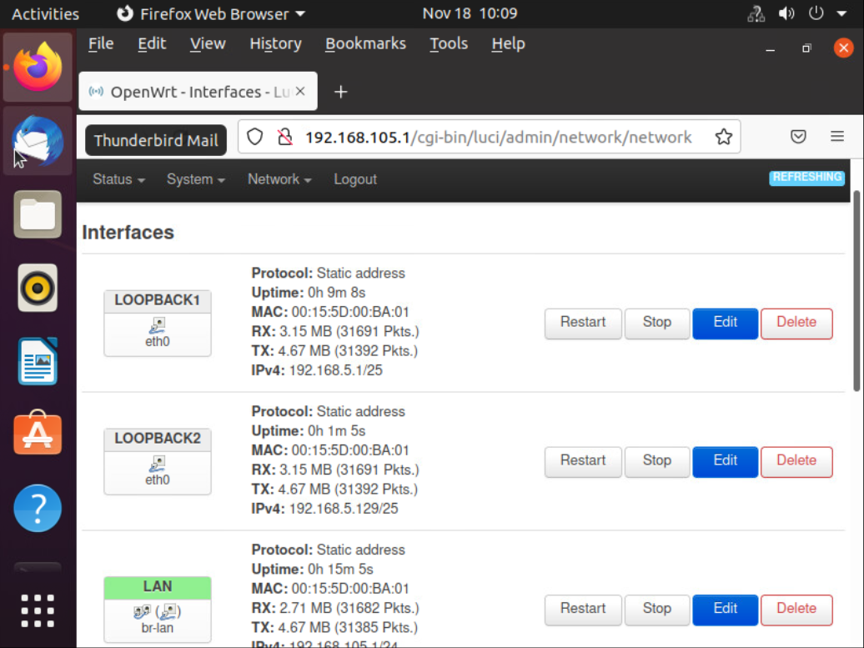
Loopback Interfaces
Screenshot of Loopback1 and Loopback2 interfaces and their IPv4 addresses.

Slide 16
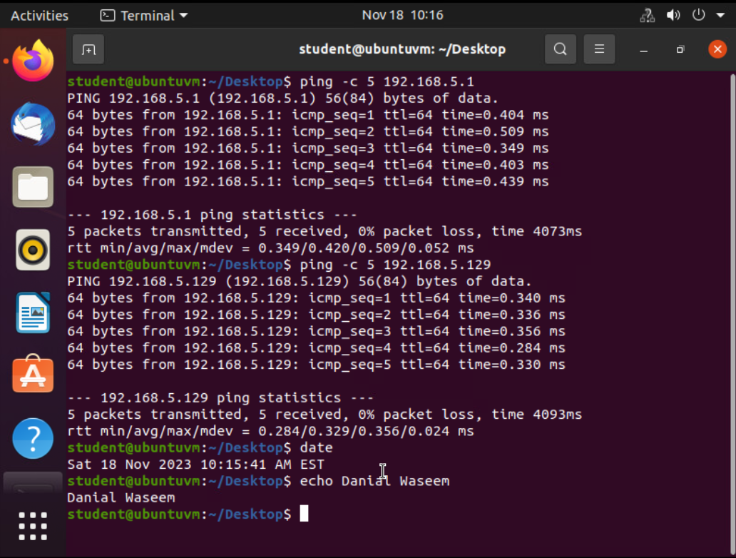
Connectivity Tests
Screenshot of two successful ping tests:
From Computer 1 to the Loopback 1 interface.
From Computer 1 to the Loopback 2 interface

Slide 17
With administrative access to our router/modem at IP address 192.168.105.1, we can log in and view the network connections.
The block address is 192.168.5.0/24, with a network mask of /25. We can calculate the subnet mask, broadcast address, first usable host address, and our IPv4 address.
By switching the protocol from DHCP to Static, we set the IPv4 address for the first subnet to 192.168.5.1 and the network mask to 255.255.255.128.
We can now further divide our network into another segment using the second subnet ID based on the provided IP values.

Slide 18
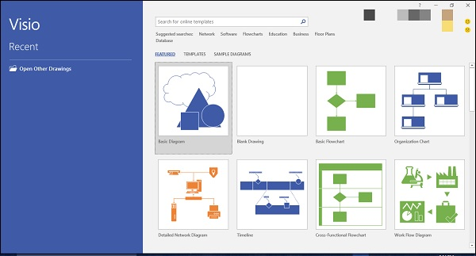
Visio diagram of Network Topology
A network’s topology illustrates connectivity.
Computer 1 and Computer 2 virtual machines are connected to a virtual switch and the SOHO router providing a successful network connection.
In prior stages, we assigned new IP addresses to both computers and configured loopback addresses while understanding the implementation of our network by segmenting and subnetting.
This Photo by Unknown Author is licensed under CC BY-SA

Slide 19
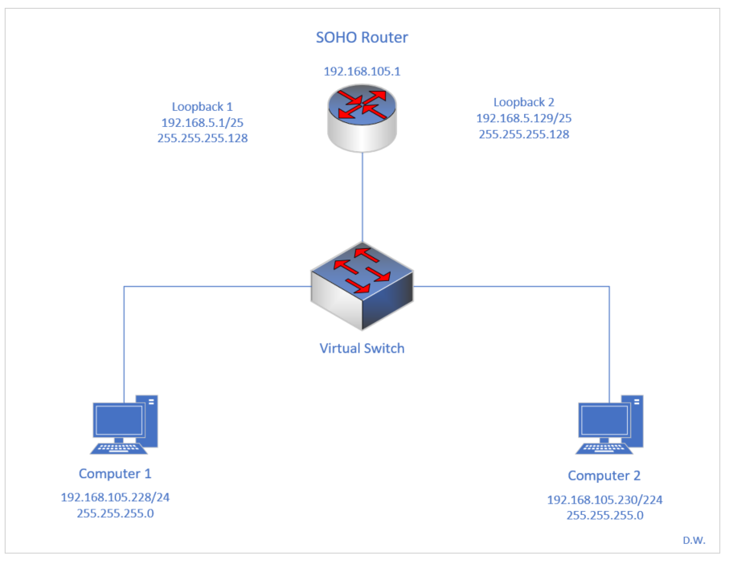
Microsoft Visio Network Diagram
Interconnection of Computer 1, Computer 2, and a SOHO Router along with IP addresses and labeling.
This diagram helps clarify the reasons behind the IP assignments, loopback address implementations, and successful data packet transfers, all presented in a visual network layout.

Slide 20
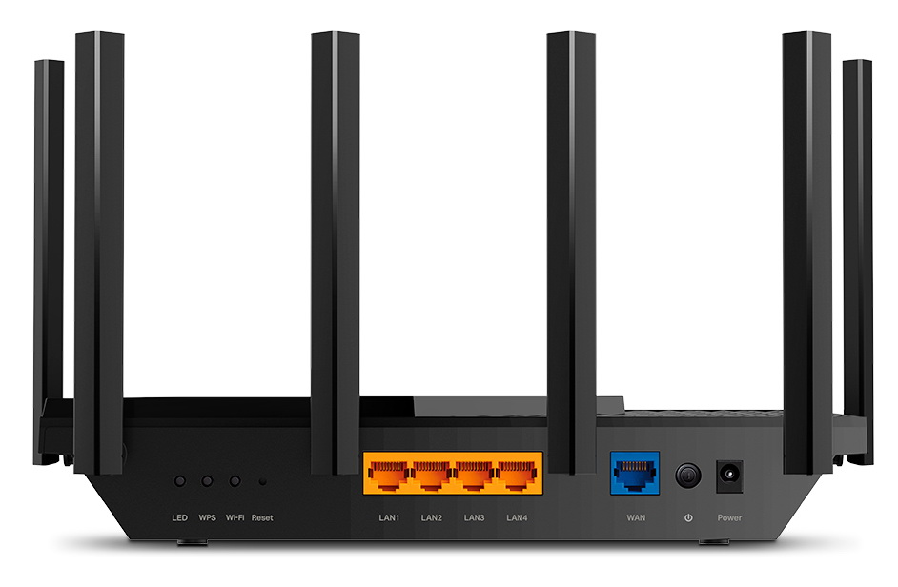
SOHO Wireless Network Security
Working with the modules within a TP-Link emulator simplifies configuring and understanding our SOHO networks security management.
The emulator offers insight into the router’s security requirements, including Static or Dynamic IP configuration, Mac Filtering for access control, and Wi-Fi protocol settings such as WPA2-PSK AES encryption standards on a 2.4GHz channel.
This Photo by Unknown Author is licensed under CC BY-SA

Slide 21
SOHO Wireless Network Security
Default Username is admin and password is admin. The default password and username is available for anyone to see, changing this secures the network otherwise anyone can login and make changes to our network. With the log ins easily available online.
To further protect a SOHO Wireless network, it is important to note, the DHCP Settings for a TP-Link router on a SOHO wireless network can be disabled to configure static IP addressing manually or DHCP server can be enabled for dynamic assigned IP addresses.
If the SOHO network has devices or servers with a requirement for control purposes and better network performance, then static addressing is more beneficial. If, however, guests are connecting to our network, it is easier to have DHCP enabled to assign IP addresses dynamically.
This network can be configured to have a “guest” network with dynamic addressing while the SOHO network has reserved IP addressing for control by managing the MAC Addressing with IP address of said devices/servers.

Slide 22
SOHO Wireless Network Security
By using the MAC Filtering feature, we can gain more control of wireless stations connecting to an access point. The rules applied through MAC Filtering can be allowed or denied to remove a user from accessing our SOHO network. If the “Allow” feature is enabled and the station, however, has no entries, then no wireless station can connect to the access point because the option has no specified addresses to compare to, that will allow access to the network.
The standard wireless security settings found within most routers are WPA/WPA2, WEP security. Recommended by TP-Link is to have WPA2-PSK AES Encryption enabled which is the current strongest standard for wireless security.

Slide 23
SOHO Wireless Network Security
Among the configurations explored in this module, identifying with a single true security function is challenging because security requirements are situational. For example, if within a home environment, employing Dynamic IP configuration alongside a firewall can monitor and block unwanted traffic effectively. Additionally, incorporating WPA2-PSK AES encryption and utilizing a VPN for confidential work will enhance security best. Furthermore, as network administrators, the ability to fine-tune security by implementing a combination of static and dynamic IP addressing, allows specific devices to benefit from static IP addressing with dedicated firewalls. Employing MAC filtering provides us an additional layer of security by preventing any unauthorized devices to access our SOHO network. Lastly, keeping updated software and firmware must be considered for best practices with network security.
After deploying all the strategies throughout this project, I would safeguard my personal home network by implementing a router that receives a LAN connection from the ISP. This router will have a build-in Firewall and would then connect to a switch, enabling access to the router and switch configurations from a central computer via a LAN between the two. For Wi-Fi security, I would enable WPA3 encryption on both the router and switch. For coverage and performance, I would deploy a mesh-style network with additional wireless extenders across my property. Finally, I would incorporate network monitoring software with IDS and Anti-Malware features to enhance overall security.

Slide 24

From network configurations to firewall functionality of mesh or hybrid style networks, TP-Links module emulator provides a practical example of network security and setup working with a 2.4GHz connection. WEP2, Mac Filtering, and IP Addressing determine functionality and security of our SOHO networks.

Slide 25

Challenges
Challenges are great for growth, but I did face some along the way.
When logging into Ubuntu and Entering passwords into Ubuntu’s shell terminal for administrative access requires careful keystrokes. Navigating through information generated by the ip addr command in our Ubuntu terminal while searching for the inet protocol family is also challenging because of the volume of output.
Creating a table to document subnet notations can present as difficult requiring accurately calculated values for each netmask ID and determining the first and last usable host addresses.
When working with Microsoft Visio the sizing and arranging of copper wire or LAN connections between devices are sensitive and correct placement requires custom arrangement to depict the diagram correctly.
Also maintaining a record of IP addresses and subnet information is crucial for accuracy and labeling.
Lastly, organizing MAC filtering can be a complex task we must pay close attention to the correct order input into the filtering feature with MAC addresses.
This Photo by Unknown Author is licensed under CC BY-NC

Slide 26

Skills & Growth
Effective Network Troubleshooting.
SOHO Wireless Network Troubleshooting.
Proficiency in Linux Networking Commands.
Functional Network Implementation.
Ticketing skills through IP Address Documentation
Attention to Detail.
Application of Network Protocols for Configuration and Connectivity.
Conceptual and Logical Network Design.
Network Security Planning and Implementation.
Designing Infrastructure for Security, Cloud Access, and Automation.
This Photo by Unknown Author is licensed under CC BY-NC-ND

Slide 27
Summary
With valuable insights and hands-on experience through network management and security. We learn how to access and configure a SOHO router, assign IP addresses, and learn to recognize where troubleshooting is necessary. Through the practical exercises we gain proficiency in networking commands, network design, and the application of network protocols. Additionally, we dive into the importance and significance of network security while paying attention to each detail with MAC Filtering and firewall configurations. This project has equipped me with essential career skills in network administration and security, allowing for the right preparation of real-world networking challenges or opportunities.

Slide 28
References
Garn, D. (2022). 4 IP Configuration Commands Every SysAdmin Should know. CompTIA. Retrieved from https://www.comptia.org/blog/ip-configuration-commands
West, J. (2022, 2019). CompTIA Network+. Cengage Learning, Inc., 9th edition.
National Center for O*NET Development. 15-1231.00 - Computer Network Support Specialists. O*NET OnLine. Retrieved November 11, 2023, from https://www.onetonline.org/link/summary/15-1231.00
Linkedin. (2023). What network challenges do you need to be prepared for in a Network Administrator interview? Linkedin. Retrieved from: https://www.linkedin.com/advice/1/what-network-challenges-do-you-need-prepared#network-protocols
Hot Technology: Microsoft visio. O*NET OnLine. (2022, July 30). https://www.onetonline.org/search/hot_tech/example?e=Microsoft%20Visio
Sushree, S. (2023). 11 Essential Network Engineer Skills (With Salary). Indeed. https://www.indeed.com/career-advice/resumes-cover-letters/network-engineer-skills
TP-LINK. (2023). TP-Link Emulators. TP-Link Corporation Limited. https://www.tp-link.com/us/support/emulator/
Fastiggi, W. (2023). Security Essentials for SOHO Networks: Safeguarding Your Digital Realm. Technology for Learners. https://technologyforlearners.com/security-essentials-for-soho-networks-safeguarding-your-digital-realm/

