Slide 1

Final Course project
Operating systems: Linux
Project By: Danial M. Waseem
Professor: Bola tilghman

Slide 2
Introduction
I will be showcasing a compilation of the work that I have completed in our Introduction to Operating Systems course at DeVry University. This work contains a demonstration of Linux OS in the following order:
  Linux File System Hierarchy
  Linux Shell Scripts
  User & Group Management
  Network Configuration
  System Performance Monitoring

Slide 3

Linux File system hierarchy

Slide 4
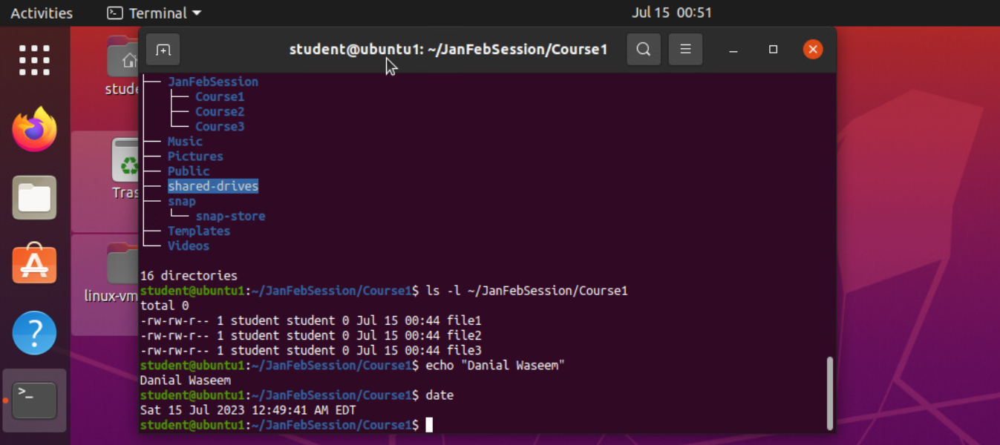
Create directories and files

Slide 5
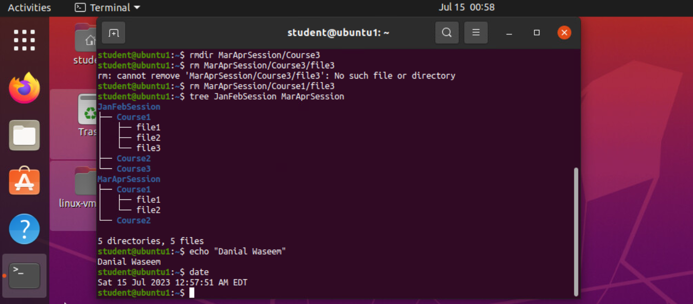
Copy and remove directories and files

Slide 6
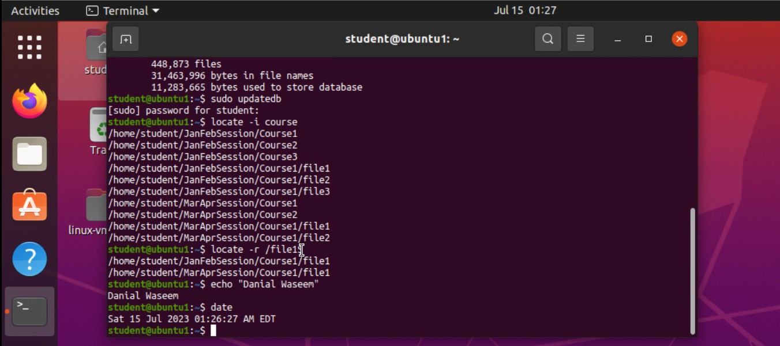
Locate directories and files

Slide 7
Linux Shell scripts

Slide 8
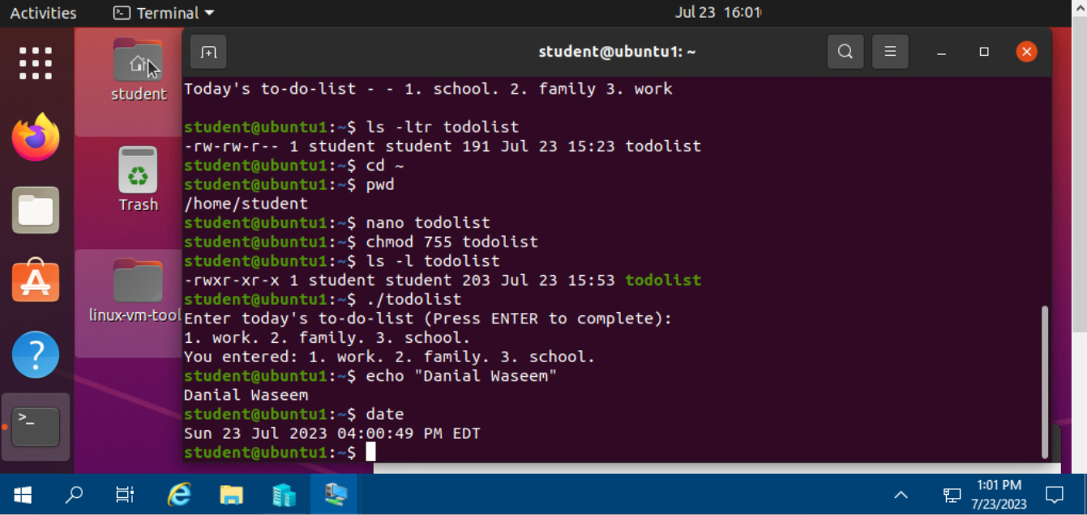
Change script file permissions

Slide 9
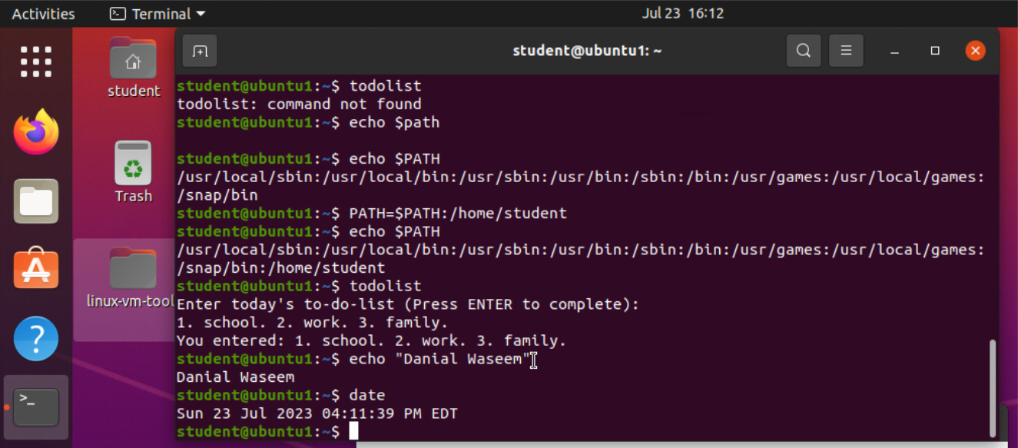
Set the PATH variable

Slide 10
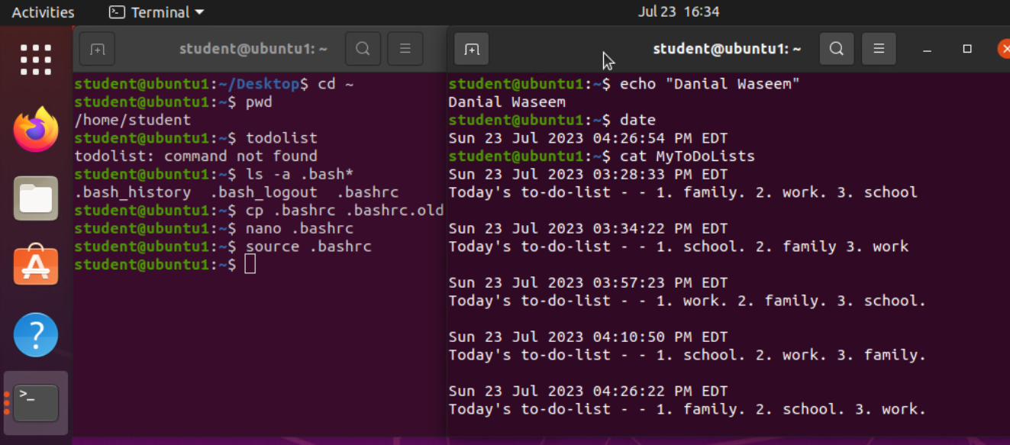
Make the PATH variable permanent

Slide 11
Linux User and Group Management

Slide 12
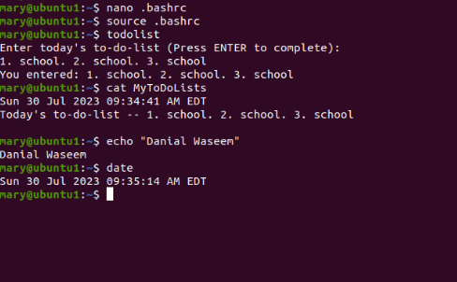
Test user and group settings
Screenshot of the output.

Slide 13
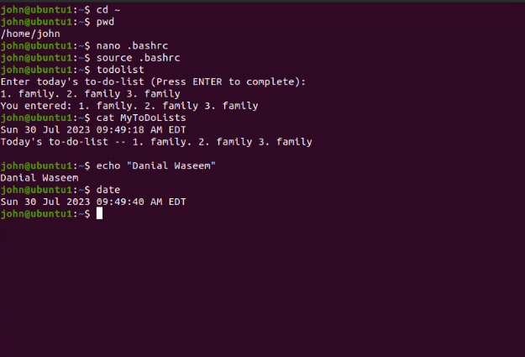
Add users in GUI
Screenshot of the output.

Slide 14
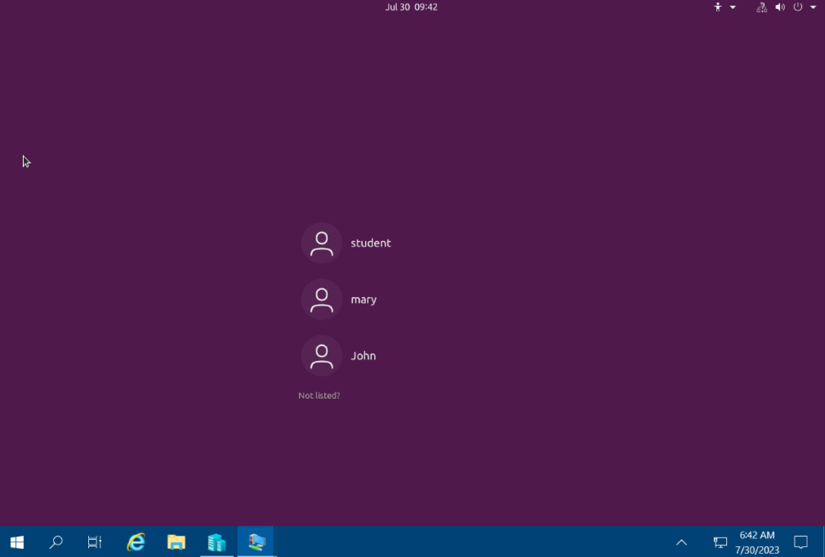
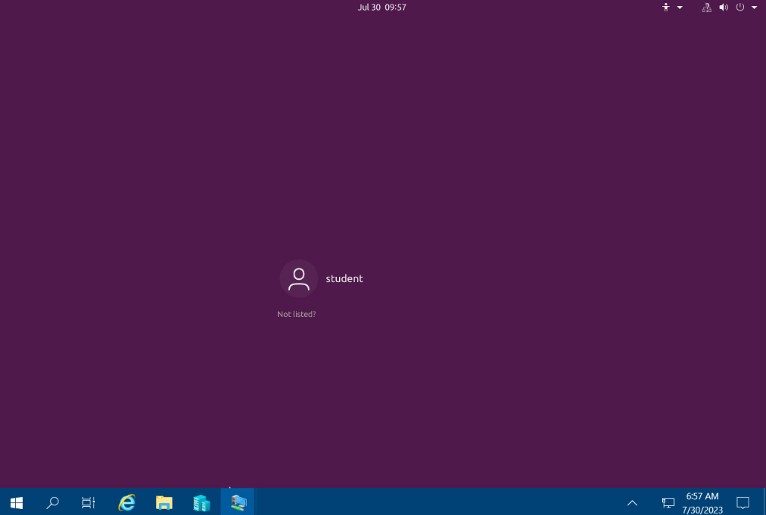
Remove users and groups
Screenshot of the log on page with three user accounts.
Screenshot of the log on page with only student user account (i.e., student).

Slide 15
Network Configuration

Slide 16
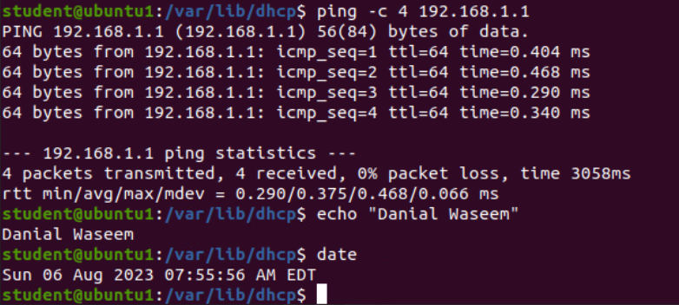
Discover host IP configurations
IP address of your Ubuntu machine.
192.168.1.107/24
IP address of its default gateway.
192.168.1.1
IP address of its DHCP server?
192.168.1.1
IP address of its DNS server?
192.168.1.1
Screen shot of output.

Slide 17
Manage network interfaces
Which DHCP message is shown in the output of the sudo dhclient –v –r eth0 command?
DHCPRELEASE
Which four DHCP messages are shown in the output of the sudo dhclient –v ens33 command?
DHCPDISCOVER
DHCPOFFER
DHCPREQUEST
DHCPACK

Slide 18
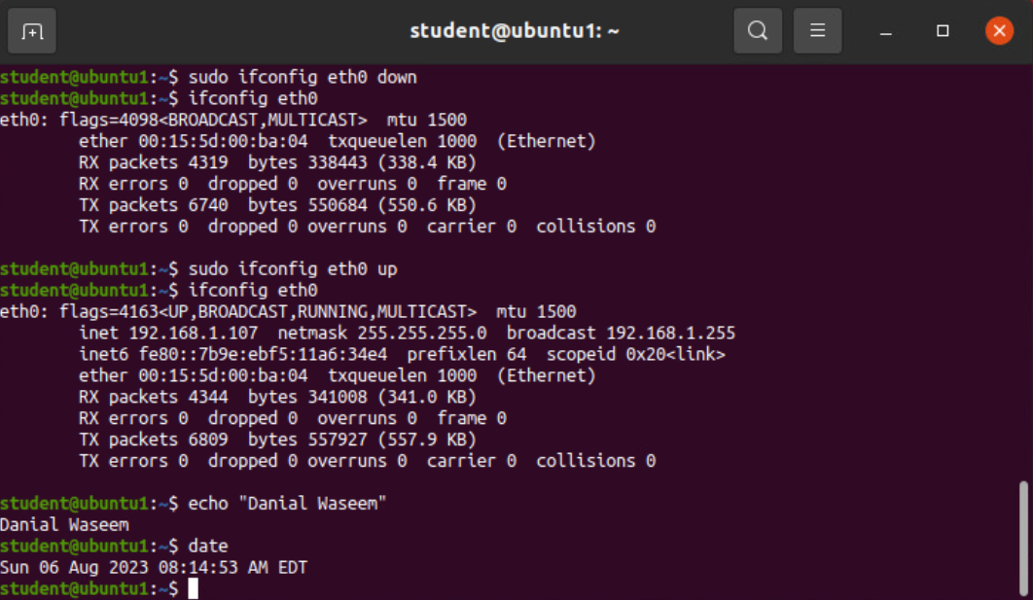
Use network utilities
Screen Shot of the output.

Slide 19
System performance & monitoring

Slide 20
Monitor Linux processes
1. What is the default action of the 15 SIGTERM kill signal?
This will kill a specific process. Here we killed the calculator.
2. In the System Monitor window, click on % CPU to sort the processes by CPU load. Which process shows the highest percentage of CPU usage?
Gnome shell shows the highest percentage of CPU usage.
References:
1. Week 6 live session meeting.
2. Week 6 video/instruction in CANVAS shell.

Slide 21
Monitor user activities
Issue the sudo accton on command to turn on GNC accounting. Run the sudo updatedb command. Enter lastcomm updatedb to check if the updatedb command was executed before. Remember to turn off GNC accounting (sudo accton off) after answering the questions.
1. What flag value is displayed in the output?
Flag value is ‘s’ due to using the sudo command.
2. Why is the name of the user who ran the processes shown as root, not student?
The root user is the superuser or administrator because we used sudo before the command.
References:
1. Week 6 live session
2. Week 6 video/instruction in CANVAS shell.

Slide 22
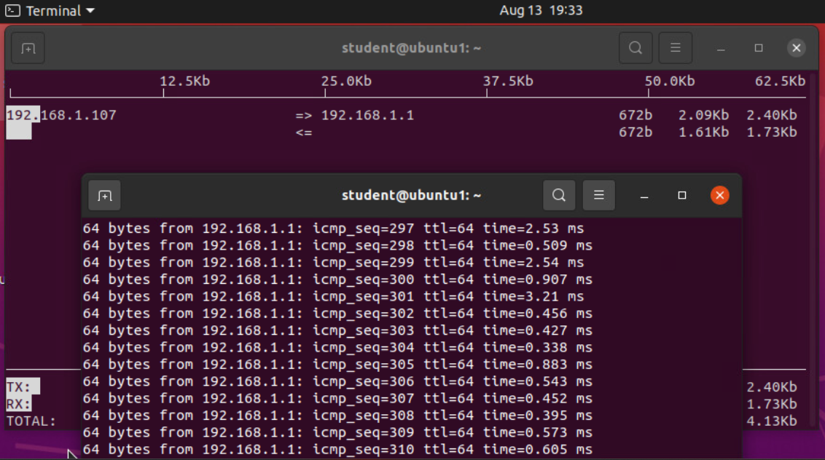
Monitor network bandwidth usage
Screenshot of the output.

Slide 23
Challenges
  Understanding input/output, utilizing the pipe feature and systematically applying them within a command script.
  Case sensitive commands and options.
  File system Hierarchy structure can be overwhelming at first.
  A multitude of commands and options, memorizing all of them within a shell environment is challenging.
  Understanding network protocols as abstract layers having their own functions and comprehending how they interact.
  Managing permissions within file and directories and understanding values to use according to permission assigned.
  Learning the correct placement of commands, along with their associated arguments and applied options.
  Comprehending the output that follows after executing commands written in shell.

Slide 24
Linux Career Skills
  Utilize package managers (apt, yum) to install, update and manage software packages ensuring a secure updated system.
  Navigate and manage Linux file system structure, understanding directory organization and key system directories.
  Remote administration enabling efficient management of Linux Systems from remote locations.
  Develop and execute shell scripts for task automation, enhancing efficiency in system management.
  Creating user and group administration, modifying and managing user accounts, permissions and access controls.
  Configure network settings, IP addresses, routing and interfaces, ensuring communication within network environment.
  Utilize monitoring tools to track system performance metrics, identifying bottlenecks and optimizing resource utilization.
  Continuous integration and Continuous Deployment (CI/CD) principles

Slide 25
Conclusion
  Learning the intricacies of the Linux system has provided a deeper understanding of the many applications within business networks. From administering permissions for directories and files to the addition of users who contribute to efficient operations. I have discovered that Linux excels in task automation, enabling the user to streamline processes and productivity. The interconnection of a network of computers was challenging to conceptualize but I now have an appreciation of understanding the simplicity in building this cohesive network. Also, understanding this ecosystem throughout our course and projects I can view this system through a security lens. Linux being an open-source system allows for greater customization to meet each industry specifics and their standards accordingly. This journey has uncovered Linux as a dynamic tool and I am excited to get more hands on with the operating system. I look forward to the opportunity of gaining an even broader perspective and understanding.

Slide 26

Thank You
danialwaseem516@gmail.com

