Slide 1
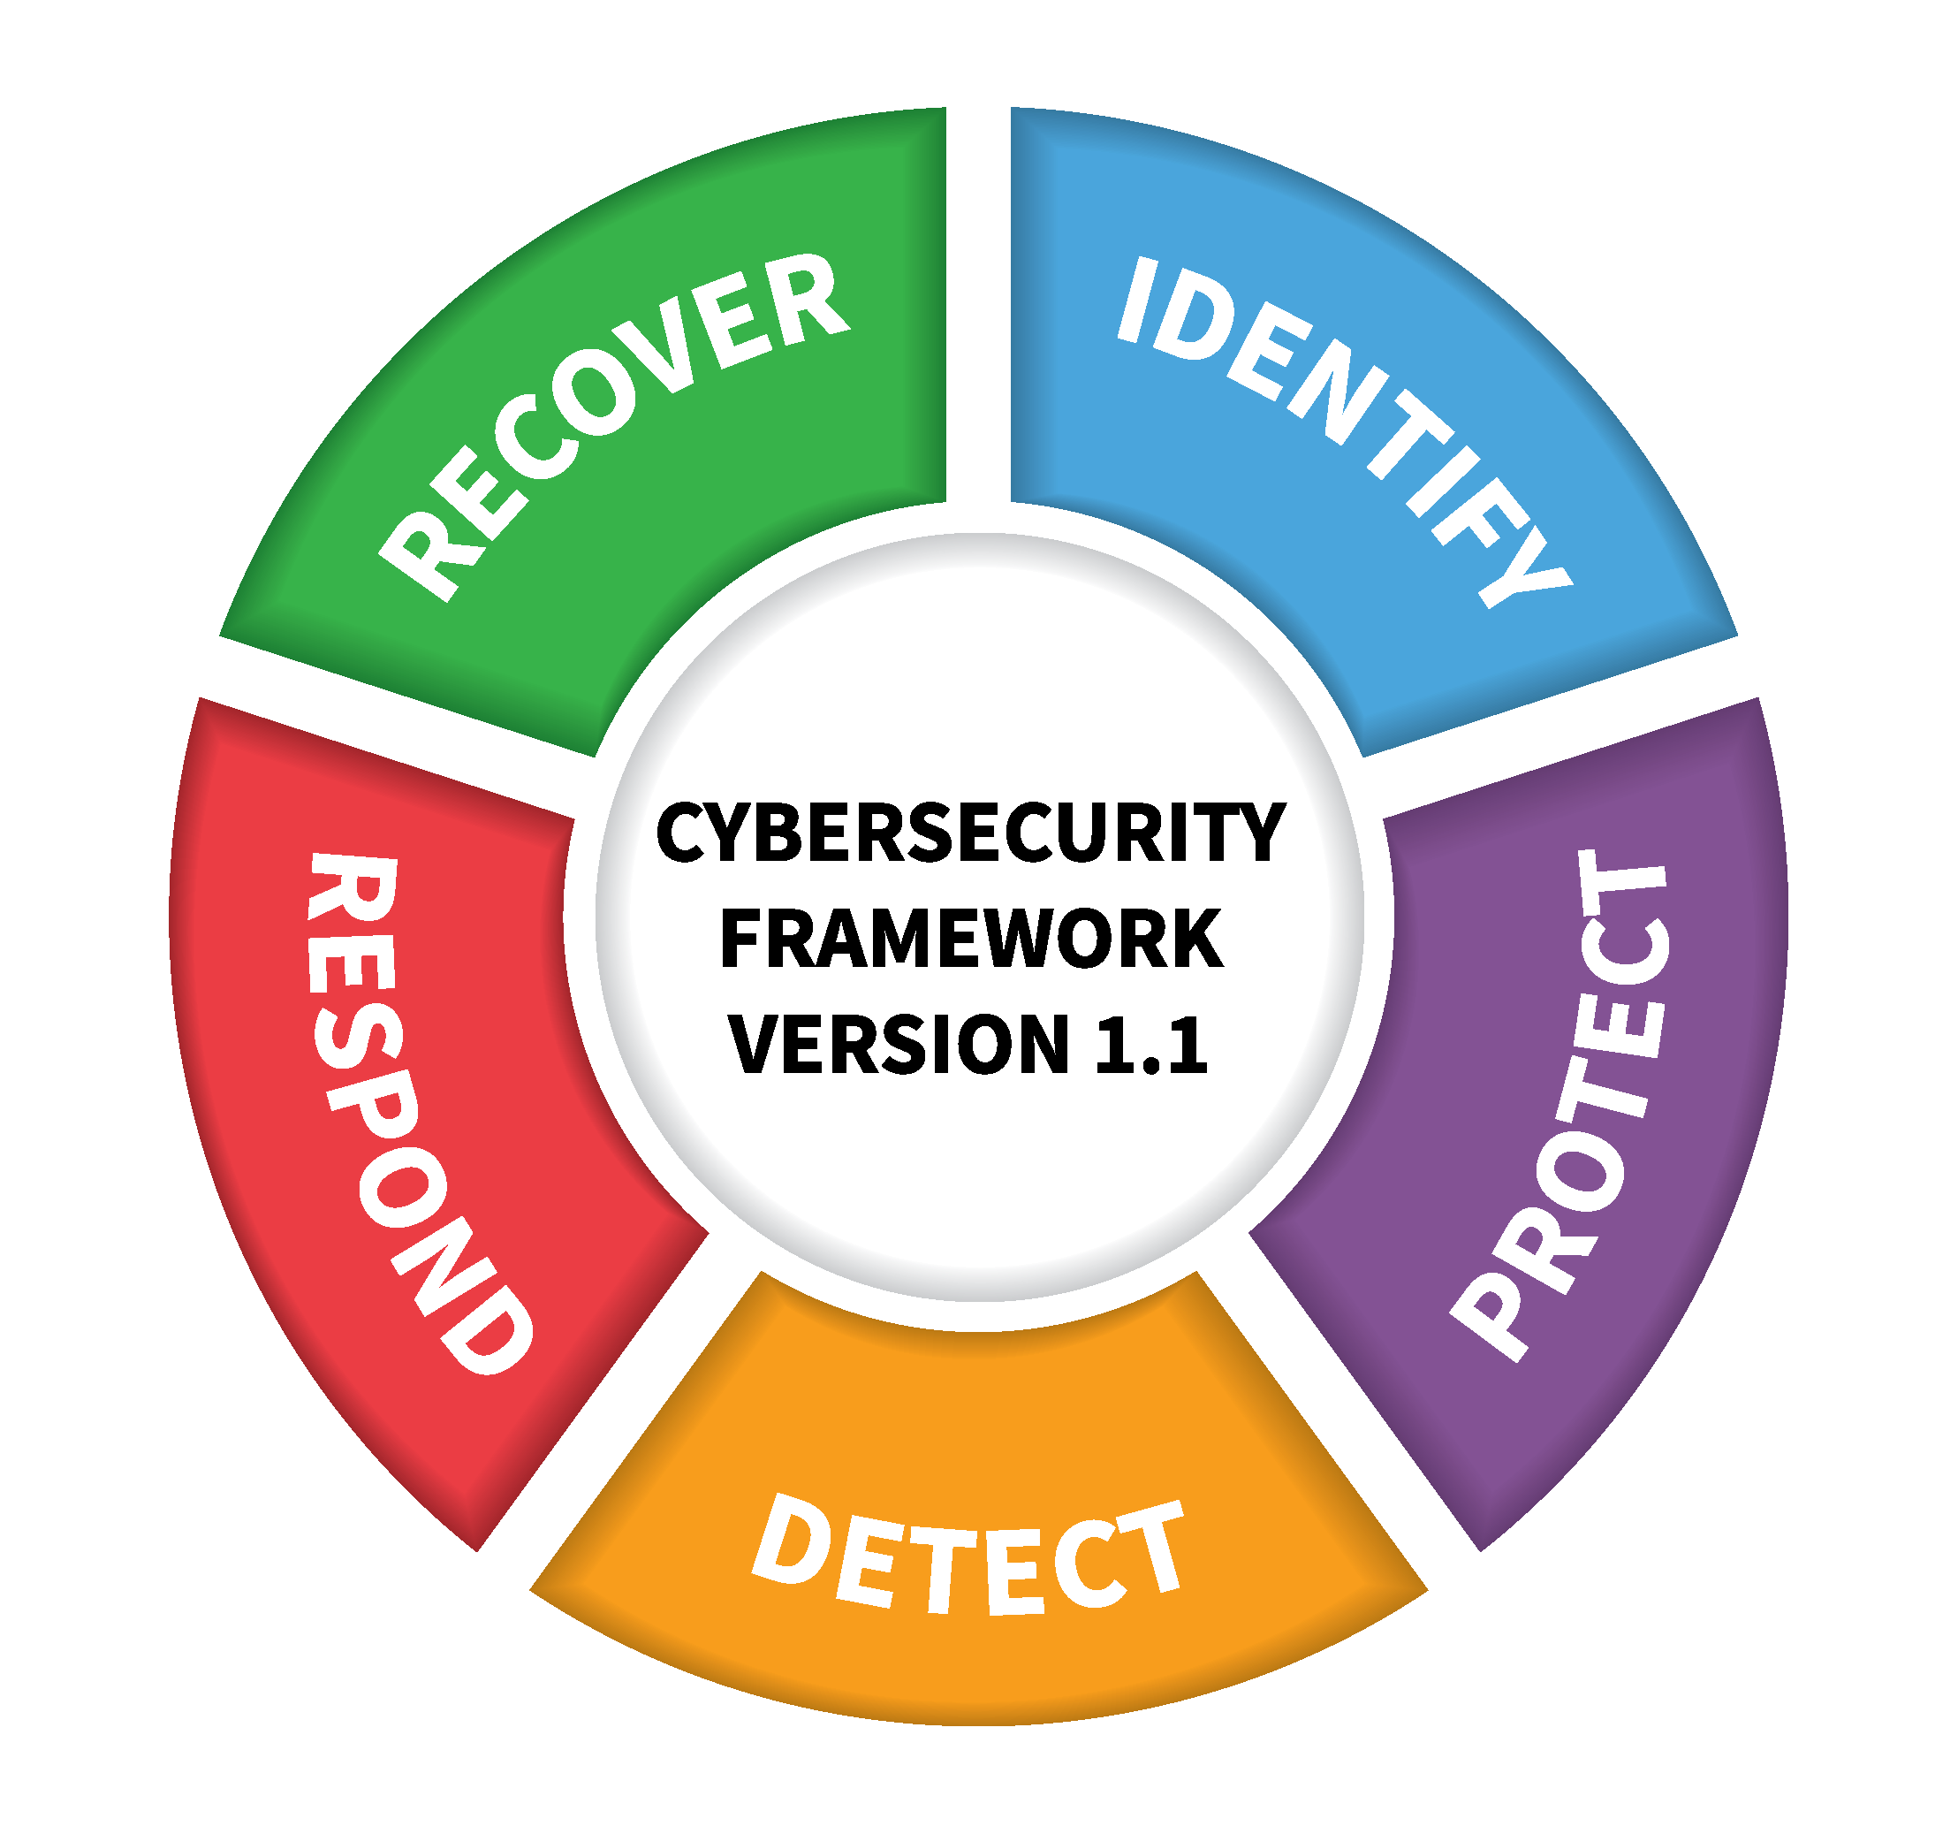

NIST Cybersecurity Framework
By Danial Waseem
Course Project
SEC310 – Professor Michael A. Cianciotta
October 17, 2023

Slide 2
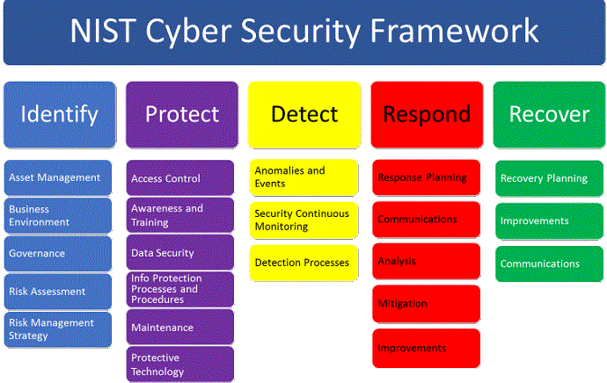
The NIST Cybersecurity Framework provides guidance to industry, government agencies, and any other organizations to reduce information security risks. This framework follows a five-point structure considered Functions with subcategories under each function.
By following this guidance cybersecurity efforts align as best practices and regulations. This framework is meant to be adapted and customized to fit the needs of each organization. As organizations come into an exponential growth of data, security of that data is vital in protecting critical infrastructure and information from threats and human negligence. By evaluating cybersecurity measures, organizations can assess their exposure and decrease risk. By breaking down the five points next, we can see how this framework is implemented.
Introduction

Slide 3

The Identify Function guides an organization in developing an understanding and managing cybersecurity risks to systems, people, assets, data, and capabilities.
Understanding the context and resources that support critical functions alongside any related cybersecurity risks results in an organization’s ability to focus in on and prioritize its efforts while maintaining a consistent risk management strategy.
Function: Identify
Asset Management
  Considers physical devices, systems, software platforms, and applications by inventorying and creating policies of access Control, security, assessment, cataloguing external information systems, prioritizing resources based on criticality and value for the business or organization, assigning roles and responsibilities, and maintaining security awareness and training policies.
Risk Management Strategy
  Done by establishing and managing information security policy processes that are agreed upon by stakeholders.
Supply Chain Risk Management
  To maintain suppliers and third-party partners of information systems by routinely assessing with audits and test results and by a response and recovery plan in process with partners.
Identify

Slide 4

U.S. Department of Agriculture - Security Awareness and Training Policy
The USDA stores and maintains access to sensitive information and information systems.
USDA’s policy states, “to comply with Federal requirements to establish, implement, and support an Information Security Awareness Training program.”
NIST’s framework mentions Identifying roles and Responsibilities and implementing a process and program for Awareness and Training,
Responsible parties implementing the USDA policy include USDA Chief Information Officer (CISO) and the Chief Information Security Officer (CIO), Associate CIO for Agriculture security Operations Center, Agency and Staff of the CIO, and agency and Staff of Information Security Program Managers.
This Photo by Unknown Author is licensed under CC BY
Identify – Example

Slide 5

The NIST Protect Function is for implementing safeguards upon the delivery of critical infrastructure services. This supports an organization's ability to decrease the risk of a potential cybersecurity event.
Function: Protect
Identity Management and Access Control
  Credentials and Identities that are issues, managed, verified, revoked, and audited for authorized devices, users and process. Including remote accessibility, Permissions being managed with least privileges and separation of duties.
  Network integrity is protected by segregation and device securities.
Awareness and Training is provided
  This empowers staff and members of the organization making sure all users are informed and trained.
Data Security
  At-rest and in transit is securely protected by consistency with the ogranizations risk strategy to protect the confidentiality, integrity and availability of information.
Information Protection Processes and Procedures
  Putting this process into place ensures a baseline configuration alongside, knowledge of keeping backups, and procedures for correctly disposing of data.
  Requirements of actions under disaster and recovery plans required.
Protective Technology & Maintenance
  Remote maintenance requirements to manage all mentioned activities for optimal performance of an organization.
  Done by Audits or logs but also a standard of what media storage devices to use.
Protect

Slide 6

East Tennessee State University – Access Control Policy
ETSU’s Access Control Policy exemplifies the use of NIST Framework.
ETSU provides guidance and clarification on assignment roles, privilege assignments, account management and access procedures, information flow, and separation of duties.
Implementation in the policy is mentioned for Least privilege and limiting rights/privileges.
Stored data for logon attempts, notifications system, session control, session locks and termination.
The policy also defines access control for remote, wireless, mobile devices, data mining protection and external information systems outside of the University for processing, storing, or transmitting data.
Protect – Example

Slide 7
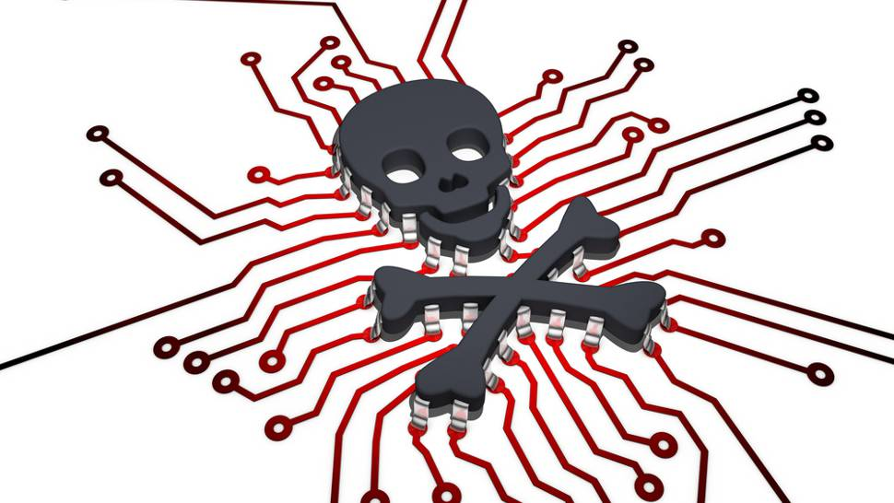
The Detect function of the NIST Framework defines activities to identify any occurrences in a timely fashion of a Cybersecurity event.
Function: Detect
Anomalies and events
  This is done by collecting data through auditing and accountability standards and gathering information from those anomalies to understand potential impact.
Continuous monitoring of security
  By protective measures within the NIST framework to follow, an organization can verify the effectiveness of network and physical activities.
  Detecting any Malicious code through logging practice, encryption standard, and vulnerability scanning standard.
Processes for detection
  Defining roles and responsibilities for accountability, awareness and communicating.
  Incident response policy helps in collecting and correlating a procedure and process.
Detect

Slide 8
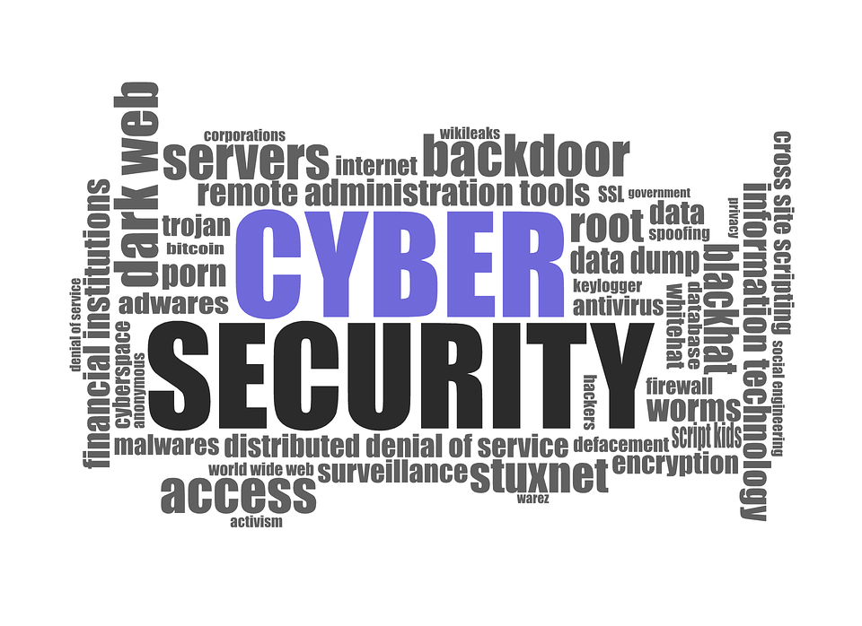
State of Maine Department of Administrative and Financial Services Office of Information Technology (OIT)
Vulnerability Scanning Standard
State of Maine OIT correctly defines procedures including proactive scanning of information assets such as Cloud software services, PaaS, IaaS and a timely handling of any vulnerabilities.
Information assets are included as technology products, business applications, system software, development tools, utilities, appliances within the scanning standard.
Also mentioned are responsibilities of partners and information asset owners such as OIT Client Tech, Network Services, Computing Infrastructure services, Data services and Application Services.
These “downstream” partners receive scan results and filter out false positives, and false negatives to identify vulnerabilities and ensure accountability.
Detect – Example

Slide 9
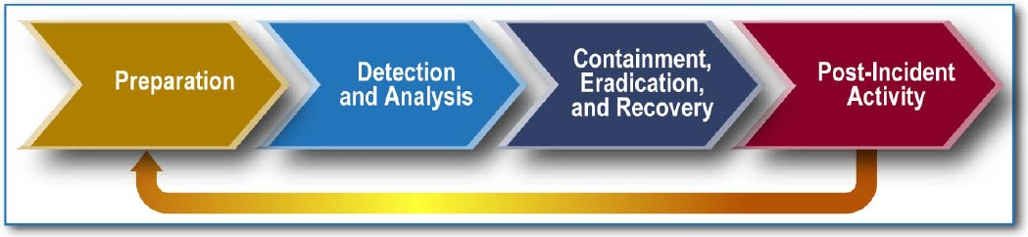
The NIST Framework function for Respond includes appropriate activities of action to take regarding detected cybersecurity incidents. This function supports the ability to contain the impact of a cybersecurity incident.
This Photo by Unknown Author is licensed under CC BY-SA-NC
Function: Respond
Respond with right planning
  This section the correct Planning policy in place helps develop a process that is executed during and after an incident.
Respond with correct communications
  Managing and coordinating communications during or after an event with stakeholders, law enforcement, and outside stakeholders.
Respond by Analysis
  Analysis during an incident response by policy is consistent and effective to support recovery activities including forensic analysis and measuring the impact of incidents.
Respond by Improvements
  With lessons learned from previous detection and response activities the organizations can mitigate and expand on resolutions in the case of an event.
Respond

Slide 10
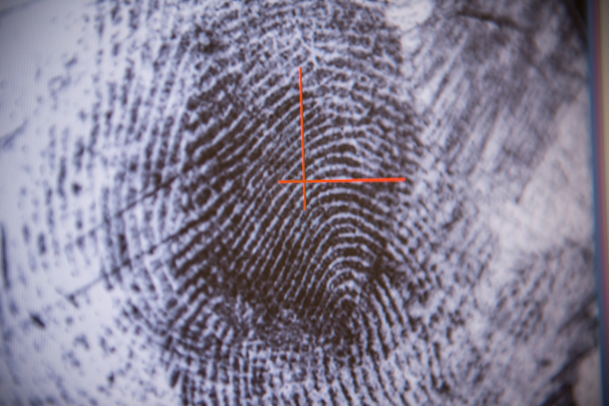
University of California, UCOP, ITS, Systemwide CISO Office, Systemwide IT Policy titled UC Information Security Incident Response Standard.
University of California presents its incident response standard by breaking up the standard into four phases: Preparation; Detection and Event Analysis; Containment, Eradication and Recovery; and Post-Incident Activity.
The standard has several criteria in place for forensic investigations. Starting with informing incidents to all members of IRTC, designating IT resources, and using pre-approved vendors for forensic investigations that support the IRT.
Preparation calls for a list of suppliers that can assist in handling an incident, any forensics required. Attaining equipment, tools UC needs such as Forensic laptops, forensic storage, and cabling. Maintaining evidence and preserving the evidence to analyze securely. This follows an in-depth approach to the NIST Incident Response Standard.
Respond – Example

Slide 11

Recover Function of the NIST Framework identifies how to maintain plans for resilience and to restore capabilities or services that may have been impaired due to an incident. This function also supports timely recovery back to normalcy with reduction of the impact from a cybersecurity incident.
Function: Recover
Recovery by Planning and Recovery by Improvements
  Planning ensures that during or after an incident by making improvements with lessons learned and by implementing updated strategies.
Recovery by Communications
  By technical measures, a system or organization should be up and running quickly and effectively, as soon as possible after an incident.
  Done through maintaining internal and external communications and coordinating this during and following the recovery from a cybersecurity incident.
Recover

Slide 12
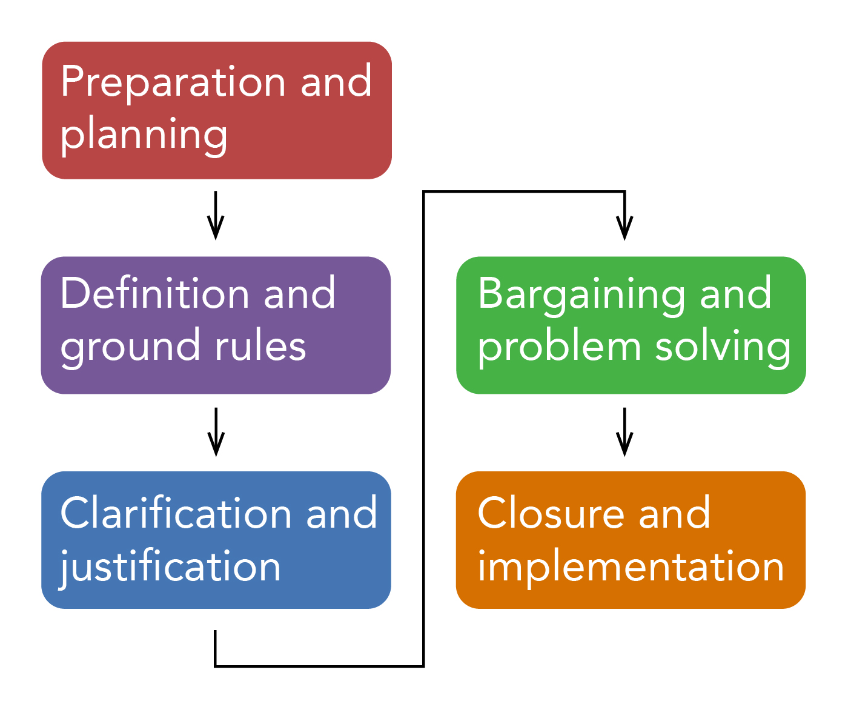
Vermont Agency of Human Services (AHS)
Contingency Planning Policy
Vermont AHS establishes requirements, responsibilities, managerial roles for contingency planning
Data protection and recovery strategies are implemented in the occurrence of a cybersecurity incident by a data backup plan, disaster recovery plan and an emergency mode operations plan.
Vermont AHS also has continuity of business and alternative processes when systems are compromised ensuring their organization is up and running after an incident.
Contingency plan testing by Vermont AHS is done annually, test results are to be reviewed within 30 days and any corrective actions should be documented and initiated.
This Photo by Unknown Author is licensed under CC BY
Recover – Example

Slide 13
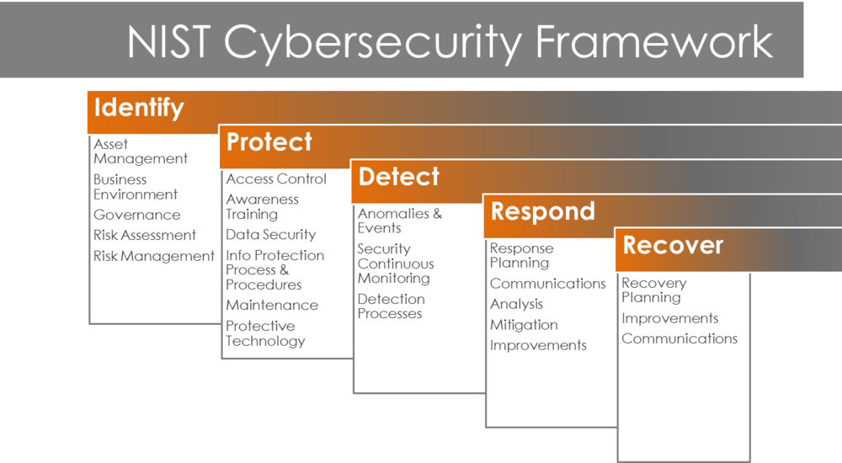
The NIST Cybersecurity Framework, offered by the MS-ISAC, provides guidance for organizations to implement a science based, measurable, information and cybersecurity policies.
While this framework can be adapted, it can and at times must be edited with additions to fit the needs of the organization.
Analyzing and comparing education and government-based policies shows that each organization respectively has adapted the framework to their needs.
Leading the development in importance of meeting specific requirements, each organization can benefit from protecting sensitive data, mitigating risk, and responding to cybersecurity incidents.
This greatly increases the output of a secure digital landscape and further maintains confidentiality, integrity, and availability.
Conclusion

Slide 14
https://nvlpubs.nist.gov/nistpubs/CSWP/NIST.CSWP.29.ipd.pdf
https://www.nist.gov/cybersecurity/cybersecurity-awareness-month
https://www.nist.gov/news-events/news/2018/04/nist-releases-version-11-its-popular-cybersecurity-framework
https://www.darkreading.com/physical-security/a-guide-to-the-nist-cybersecurity-framework
http://usda.gov/directives/dr-3545-001
https://humanservices.vermont.gov/sites/ahsnew/files/5.24%20Information%20Sercurity%20Contingency%20Planning%20Policy.pdf
https://www.etsu.edu/universitycouncil/documents/resources/2018-19/access_control_policy__3.24.19.pdf
https://www.maine.gov/oit/sites/maine.gov.oit/files/inline-files/VulnerablityScanningProcedure.pdf
https://security.ucop.edu/files/documents/policies/incident-response-standard.pdf
Images:
https://pixabay.com/es/direcciones-flechas-perdido-s%C3%ADmbolo-2543956/
http://gate.energy/gateoss-nist-framework/
https://isc.sans.edu/forums/diary/Cyber+Security+Awareness+Month+-+Day+18
https://pixabay.com/en/cyber-security-computer-security-1784985/
https://tekhdecoded.com/malware-protection-important-pc/
https://www.pngall.com/cybersecurity-png/download/40593
https://www.mortgagefit.com/blog/benefits-and-the-qualification-criteria-for-usda-loans/
References

