Slide 1



Optimizing Digital Signals Across Mediums
Danial Waseem
Devry University – Network 310 – Course project
April 25, 2025

Slide 2


Intro
Baseband/Modulation Basics
PCM and Line Codes
Cables and Cabling Standards
Antennas and Free Space Path
BER over Fading Channels

Slide 3
essential elements of modern digital communication systems
In this course project, we explore essential elements of modern digital communication systems. The modules cover:
Baseband signals and modulation (AM/FM)
Pulse Code Modulation (PCM) and Line Codes
Structured cabling standards and network wiring
Antenna gain and free-space path loss
Bit error rates (BER) in fading wireless channels This project develops skills in analysis, simulation, link planning, and troubleshooting within digital and wireless communication systems.

Slide 4
Baseband and am/fm signals
This module explores the fundamentals of baseband signals and how modulation techniques like AM (Amplitude Modulation) and FM (Frequency Modulation) are used to efficiently transmit data. It highlights the key differences between AM and FM and their practical significance in communication systems.

Slide 5
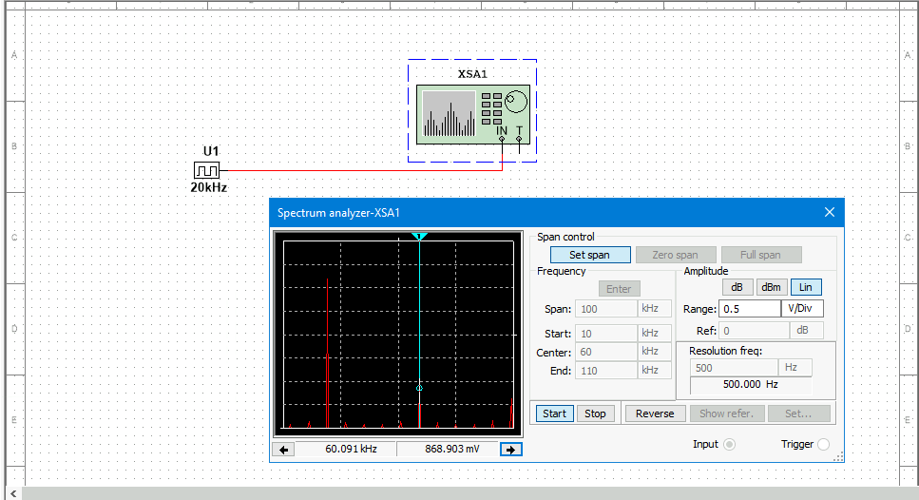
Baseband Signals
Spectrum analyzer displaying the signal’s harmonic spectrum and its panel settings. Record of the signal voltage at each of the frequencies in the table.
Harmonic Frequency | Signal (Volts)
20 kHz | 3.131 V
40 kHz | 1.553 V
60 kHz | 868.903 mV
80 kHz | 2.714 V
100 kHz | 416.689 mV

Slide 6
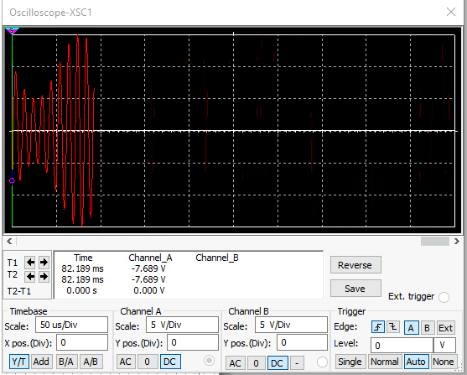
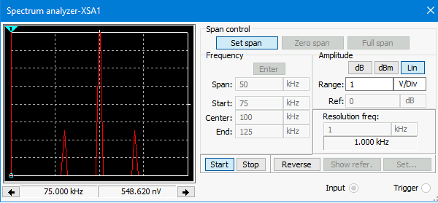
AM Signals
The screenshot shows the Oscilloscope including the signal and the panel settings of the oscilloscope. The screenshot of the Spectrum Analyzer shows the signal and the panel setting of the analyzer.
Oscilloscope
Spectrum Analyzer
AM Modulation | Frequency (kHz)
Lower side band | 90.083 kHz
Carrier | 100.000 kHz
Upper side band | 109.917 kHz

Slide 7
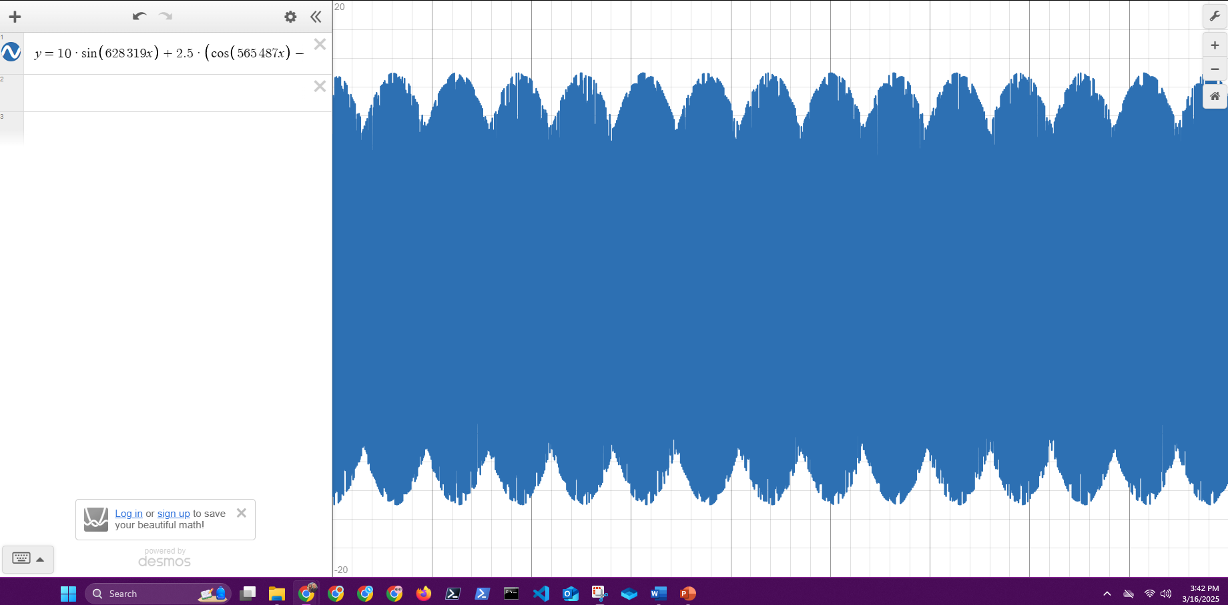
AM Signals Cont.
Equations for the carrier and modulating signals and plot the equation for the composite modulated signal V_{AM .}
Equation for carrier signal is: vC​ = Vc​sin(2πfc​t+θC​)
vC​=10sin(200,000πt)
Equation for modulating signal is: vm​=Vi​sin(2πfi​t+θi​)
vm​=5sin(20,000πt)
Plotted diagram screenshot.

Slide 8
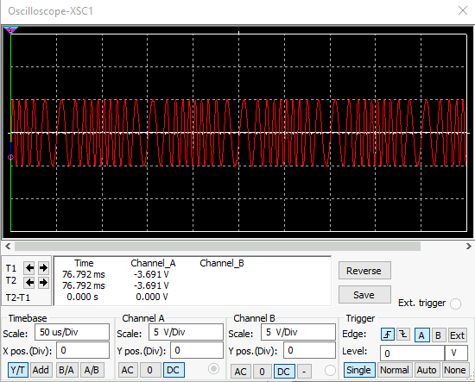
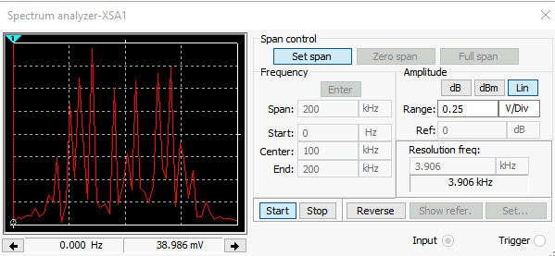
FM Signals
The screenshot of the Oscilloscope includes the signal and the panel settings of the oscilloscope. The screenshot of the Spectrum Analyzer should include the signal and the panel setting of the analyzer.
Oscilloscope
Spectrum Analyzer
Carrier frequency is 631.588 mV

Slide 9
Pulse Code Modulation (PCM) and Line Codes
Next we explore Pulse Code Modulation (PCM) and the various line coding techniques used in digital communications. PCM is the process of converting analog signals into digital form, while line codes ensure that data is transmitted reliably across the medium. The power spectral density of different line codes is compared to evaluate their efficiency.

Slide 10
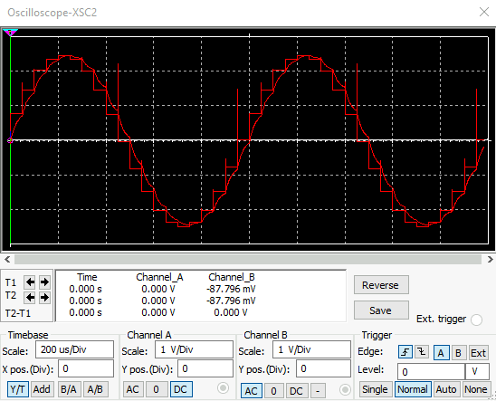
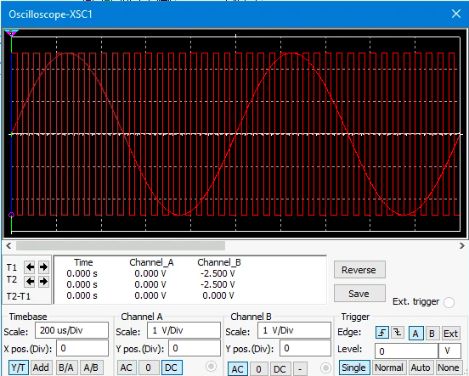
Pulse Code Modulation (PCM)
The first screenshot shows the Oscilloscope-XSC1 display with the analog input signal and sampling clock at the input to the ADC. The second screenshot shows the Oscilloscope-XSC2 display with the output of the DAC.

Slide 11
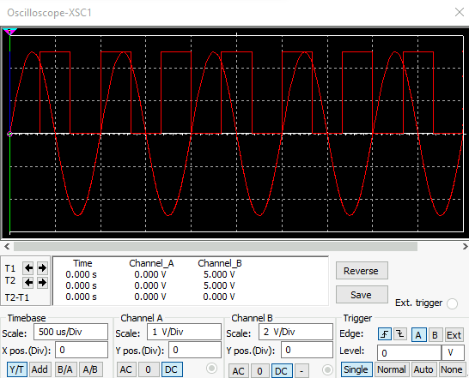
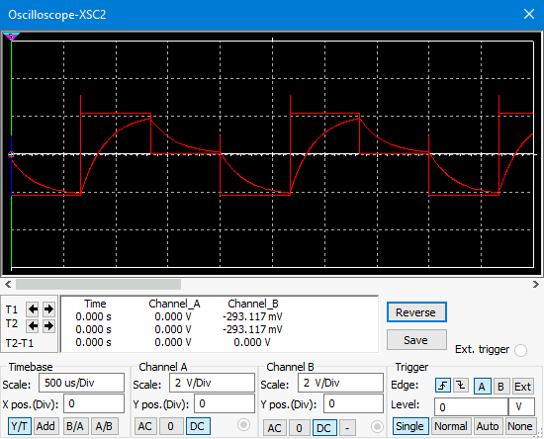
Pulse Code Modulation (PCM)
The first screenshot shows the Oscilloscope-XSC1 display with the analog input signal and sampling clock at the input to the ADC. The second screenshot shows the Oscilloscope-XSC2 display with the output of the DAC.
Increasing or decreasing the sampling rate affects the accuracy of analog signal reconstruction:
a higher sampling rate produces a smoother, stair-stepped waveform that more closely resembles the original analog signal, while a lower sampling rate results in a coarse, more distorted version of the signal.

Slide 12
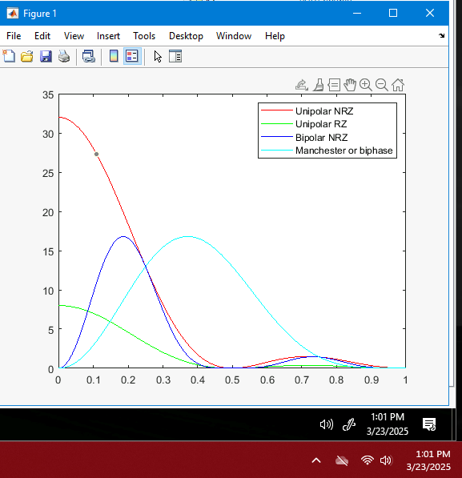
Line Codes
This screenshot shows the power spectral densities of four-line codes: NRZ-Polar, NRZ-Unipolar, NRZ-Bipolar, and Manchester-Polar.
MATLAB Diagram
Bipolar NRZ has a narrower bandwidth, with most of its energy concentrated in the lower portion of the spectrum, whereas Manchester (or biphase) has a wider bandwidth due to its energy being spread across higher frequency components. As a result, Manchester encoding requires more bandwidth than Bipolar NRZ.

Slide 13
Cables and structured cabling systems
This section examines the physical infrastructure that supports modern networks: cabling systems. It covers ANSI/TIA-568, ISO/IEC 11801 standards, plenum-rated cables, riser cables, and best practices for installation. Proper cabling and grounding practices are essential for minimizing interference and maintaining network performance.

Slide 14
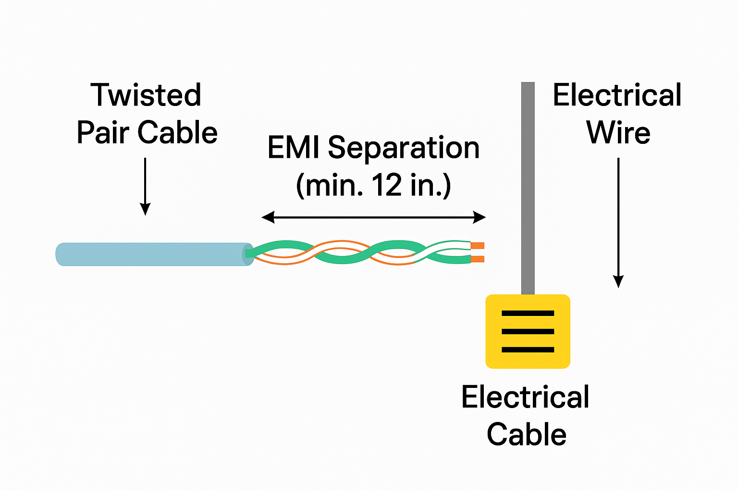
Cabling fundamentals and interference
Twisting in UTP cable pairs is essential to cancel electromagnetic interference (EMI) and reduce crosstalk between pairs, preserving signal quality.
UTP cables should be separated from 110V electrical wiring by at least 12 inches to minimize interference.
Horizontal cabling connects telecommunications rooms to individual work areas on the same floor, enabling endpoint connectivity.

Slide 15
Cabling ratings, vertical cabling, and grounding
Plenum-rated cables use low-smoke, fire-resistant materials for safe use in air ducts and ceiling spaces.
Riser tubes provide vertical pathways between floors for backbone cabling in multi-story buildings.
Grounding is primarily a safety measure but also helps reduce EMI and ensure communication system stability.

Slide 16
Antenna gain and free space path loss
This module analyzes the behavior of antennas and the impact of free space path loss on signal transmission. It explains how antenna size, gain, and frequency influence coverage and data rates. The concept of free space loss is critical for designing efficient wireless systems and link budgets.

Slide 17
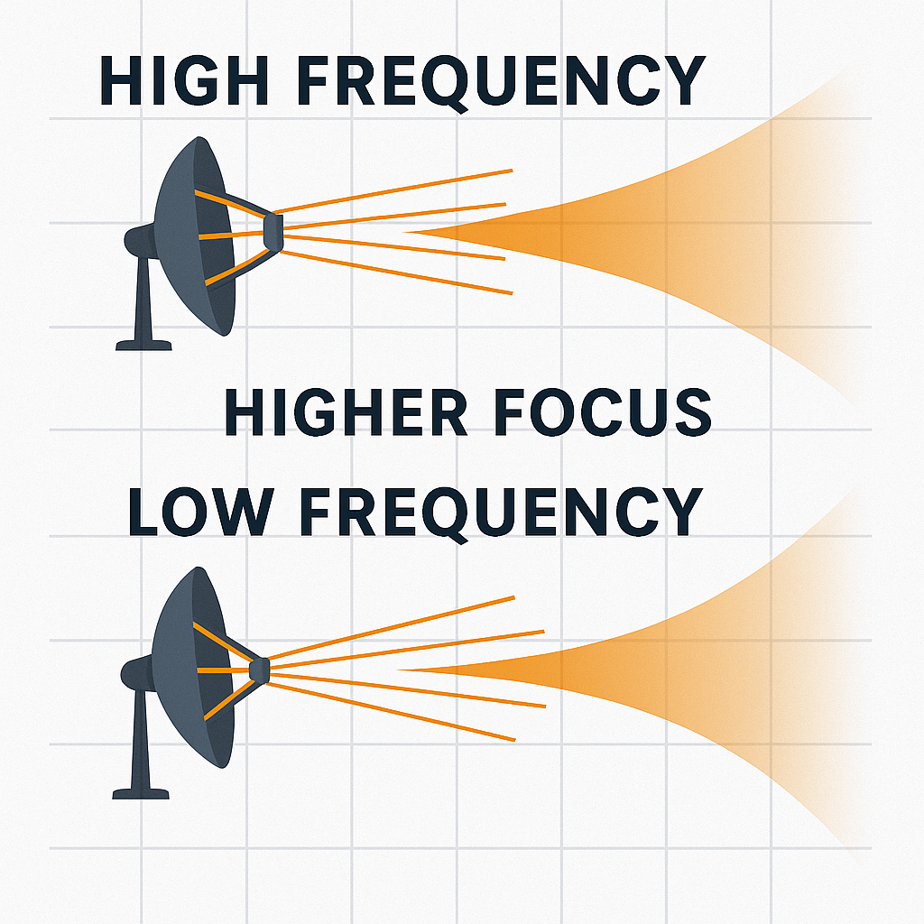
Antenna gain and dish efficiency
Dish antennas focus existing transmission power in a specific direction, increasing antenna gain.
At 2.4 GHz, a 0.5m dish has a maximum theoretical gain of 22.19 dBi.At 5 GHz, the same 0.5m dish improves to a 28.32 dBi gain.
Higher-frequency signals are more efficiently focused by dish antennas, resulting in higher gain.
A 25-meter dish like the Very Large Array (VLA) telescope achieves around 66.32 dBi gain at 5 GHz.
Larger dishes are more efficient at focusing signals compared to smaller dishes at the same frequency.

Slide 18
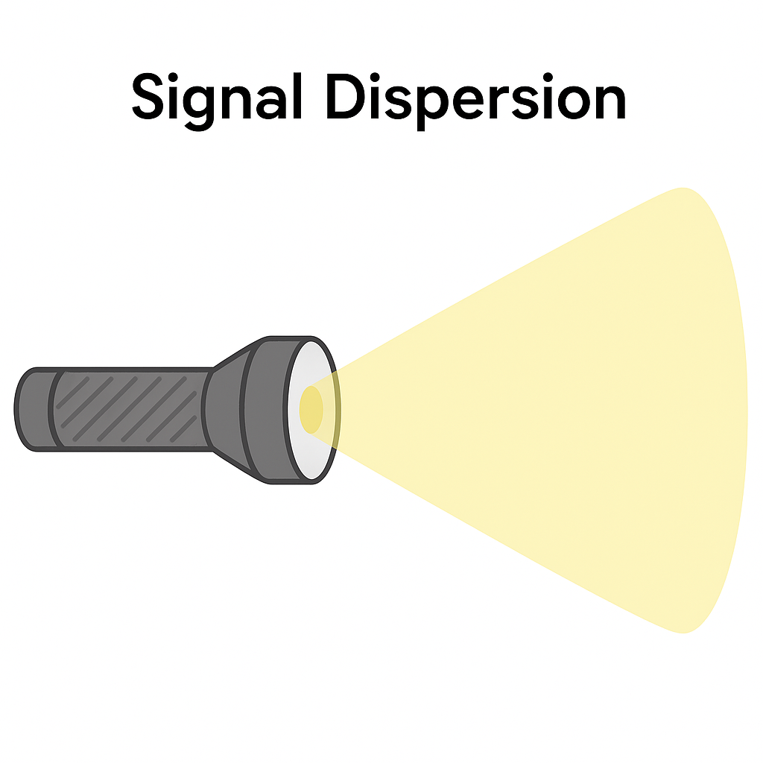
Free space path loss dynamics
Free Space Path Loss (FSPL) increases with frequency and distance.
At 2.4 GHz and 100 meters, FSPL ≈ 80.05 dB; at 5 GHz, FSPL rises to 87.57 dB.
Higher frequencies suffer greater FSPL over the same distance compared to lower frequencies.
FSPL at 20m = 66.03 dB, 40m = 72.04 dB, and 80m = 78.05 dB (2.4 GHz band).
Every time distance doubles, FSPL increases by about 6 dB.
Delta FSPL calculated for 20m to 40m: approximately 6.02 dB, confirming the doubling rule.

Slide 19
Bit Error rate of fading channels
Here, we investigate the performance of digital communication systems under different types of channel impairments. Using Phase Shift Keying (PSK) modulation, we compare bit error rates (BER) across AWGN, Rayleigh, and Rician fading channels. This module highlights how wireless environments affect system reliability and data integrity.

Slide 20
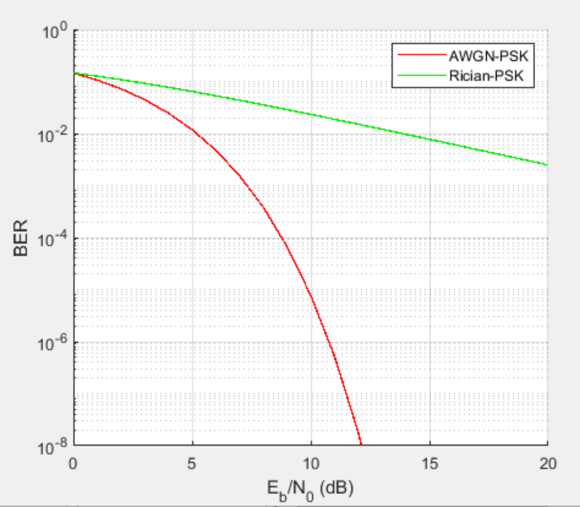
AWGN Channel and Rician Channel
This screenshot shows the bit rate error performance of both AWGN and Rician fading channels.

Slide 21
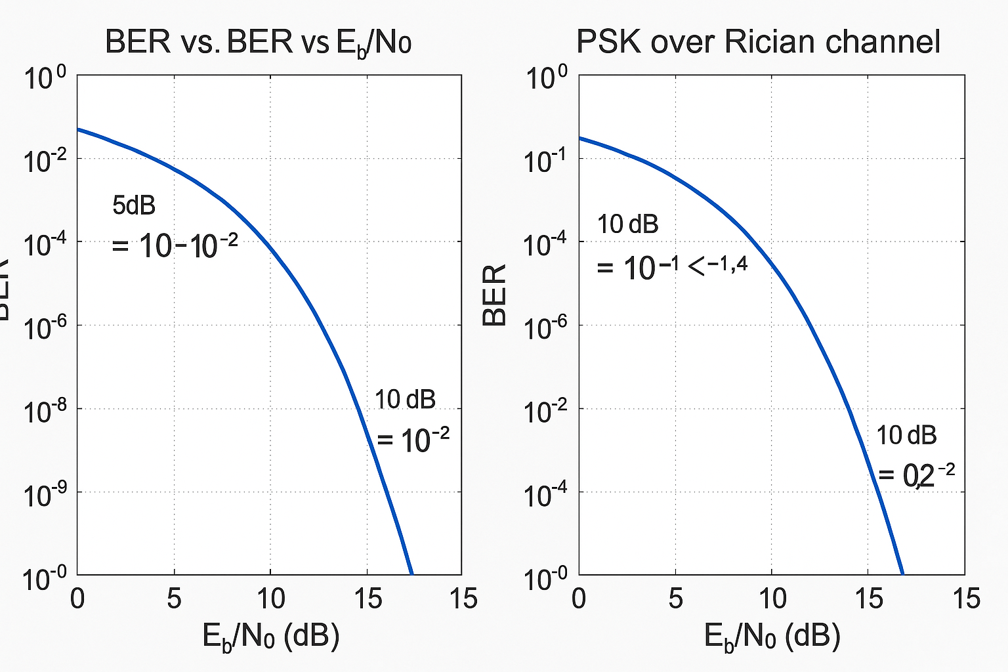
BER comparison – Awgn vs rician channel with psk
The Bit Error Rate (BER) of PSK modulation varies significantly when comparing performance over an Additive White Gaussian Noise (AWGN) channel versus a Rician fading channel.
At 5 dB SNR:
  AWGN channel maintains a BER around 10⁻², showing consistent performance.
  Rician channel BER increases to 10⁻¹.4, indicating more errors due to fading effects.
  This suggests that AWGN channels are more reliable at lower SNR levels.
At 10 dB SNR:
  AWGN improves dramatically to a BER of 10⁻⁶.
  Rician channel performance lags, with a BER still around 10⁻².2.
  Higher SNR doesn’t compensate for the multipath fading introduced by Rician channels.
AWGN channels offer consistently lower BER than Rician fading environments. This is because Rician fading introduces signal variability, leading to more frequent and severe errors, especially when precision and reliability are critical.

Slide 22
Challenges
Learning simulation platforms (Multisim, MATLAB)
Interpreting BER graphs and communication channel effects
Understanding advanced modulation and fading models

Slide 23
Skills gained
Transmission medium analysis (wired, optical, wireless)
01
Evaluating and comparing modulation techniques
02
Link budgeting and signal quality prediction
03
Application of real-world communication standards and practices
04

Slide 24

conclusion
Through this project, we have developed a solid understanding of modern digital and wireless communications. Analyzing key performance parameters like BER, SWR, FSPL, and gain enables us to design, optimize, and troubleshoot real-world communication systems.

Slide 25
references
DeVry University. (2024). NETW310 course project guide – Module 2-6. College of Engineering and Information Sciences, DeVry University.
Telecommunications Industry Association. (2001). ANSI/TIA/EIA-568-B Commercial Building Telecommunications Cabling Standard. Anixter. https://web.anixter.com/AXECOM/AXEDocLib.nsf/(UnID)/8F2E0839A6190F4986257309005757CC/$file/ANSI-TIA-EIA-568-B.pdf
Vincent. (2024, November 21). Network cable standards for generic cabling: TIA 568 vs ISO 11801 vs EN 50173. FS Community. https://community.fs.com/blog/network-cable-standards-tia-568-vs-iso-11801-vs-en-50173.html
Frenzel, L. E., Jr. (2016). Principles of electronic communication systems (4th ed.). McGraw-Hill Education.
SwissWireless. (n.d.). WLAN link budget calculator. Retrieved April 9, 2025, from http://www.swisswireless.org/wlan_calc_en.html
Cisco Systems. (n.d.). Resolve rogue detection and mitigation in a unified wireless network. Retrieved April 9, 2025, from https://www.cisco.com/c/en/us/support/docs/wireless/4400-series-wireless-lan-controllers/112045-handling-rogue-cuwn-00.html
Fluke Networks. (n.d.). Understanding electromagnetic interference (EMI) and how to prevent it. Retrieved April 9, 2025, from https://www.flukenetworks.com/blog/cabling-chronicles/understanding-electromagnetic-interference-emi-and-how-prevent-it

Slide 26

Contact details
someone@example.com

