Slide 1
CEIS150
Module 7
GUI
By: Danial Waseem

Slide 2
Rubric
Activity | Requirement(s) | Points
Stocks in GUI | Screen shot of working program | 15
History complete | Screen shot of working History Tab | 15
Report Complete | Screen shot of Report Complete | 10

Slide 3
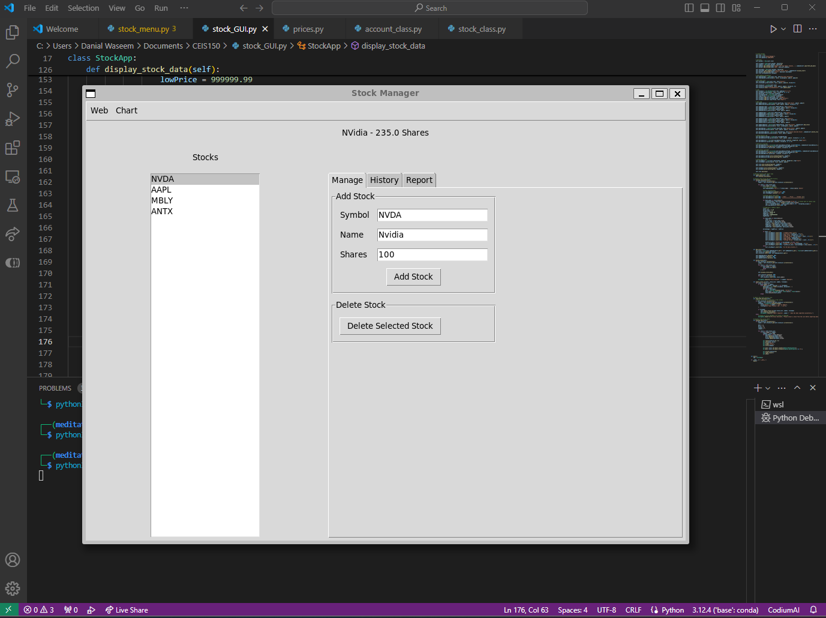
Stocks in GUI
Screen shot of GUI working

Slide 4
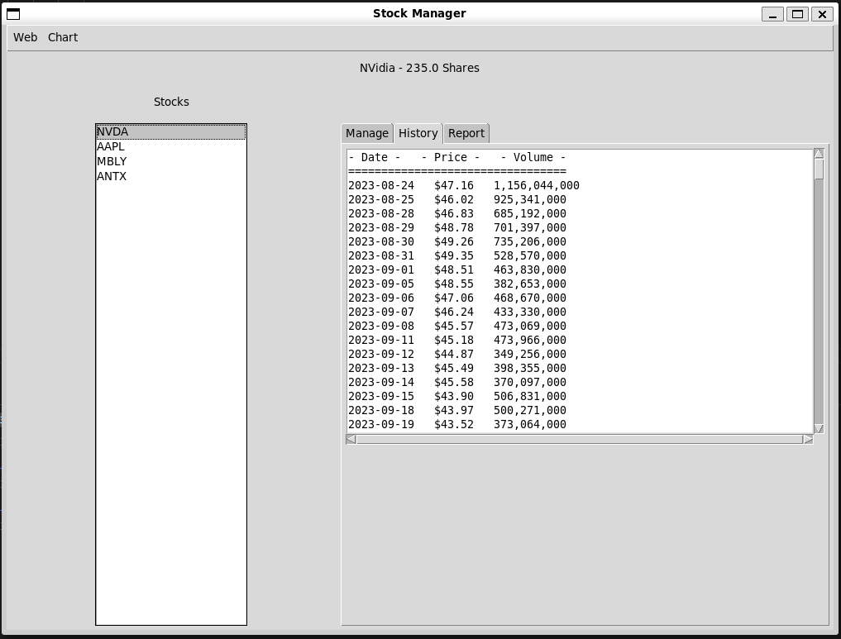
History Tab
Screen shot of History tab with import working.

Slide 5
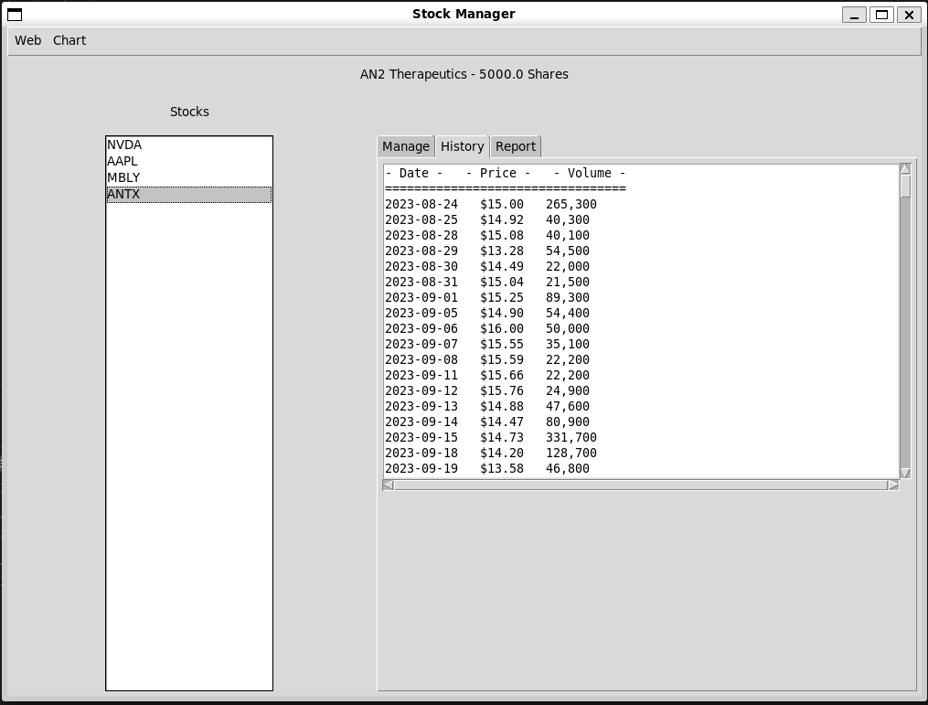
History Tab
Screen shot of History tab with import working.

Slide 6
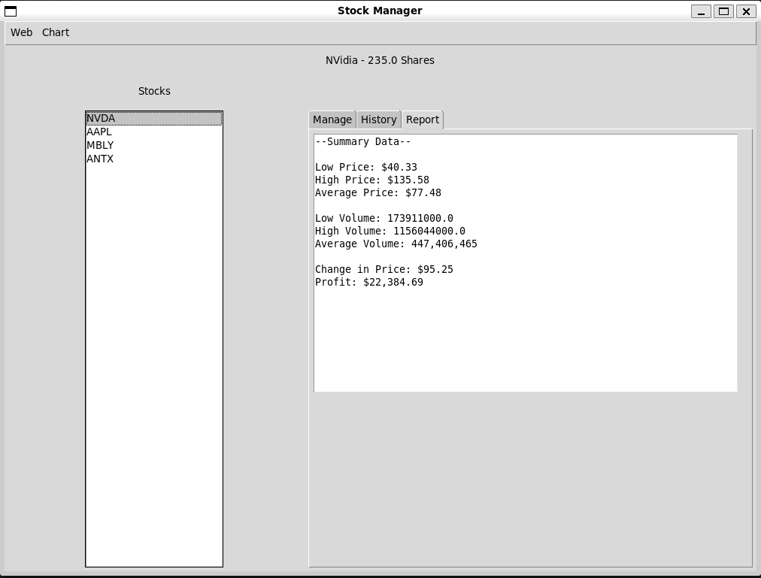
Report Complete
Screen shot of Report tab

Slide 7
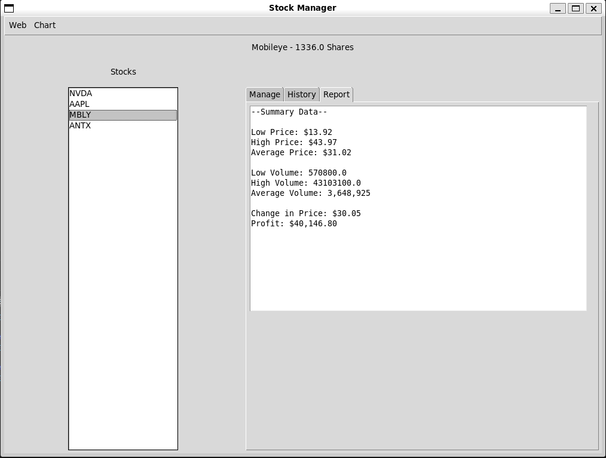
Report Complete
Screen shot of Report tab

Slide 8
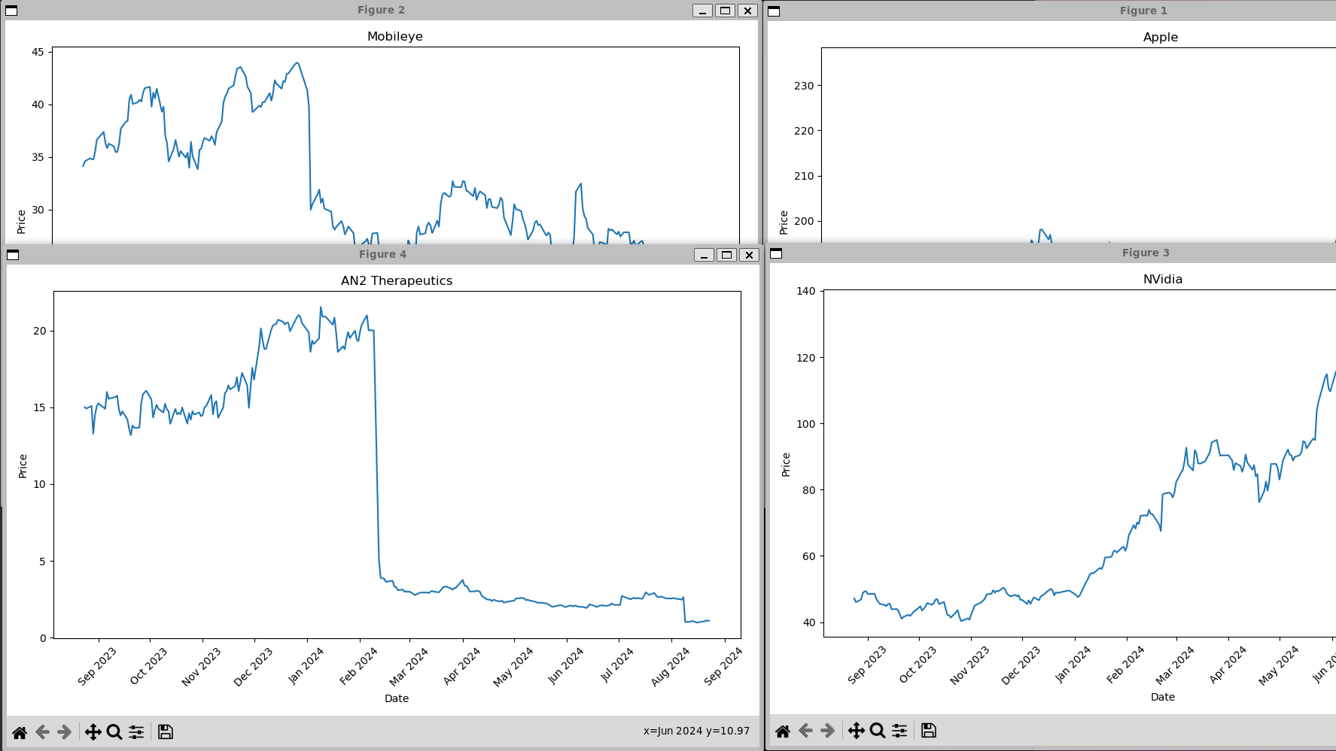
Stock Charts

